Slide 1

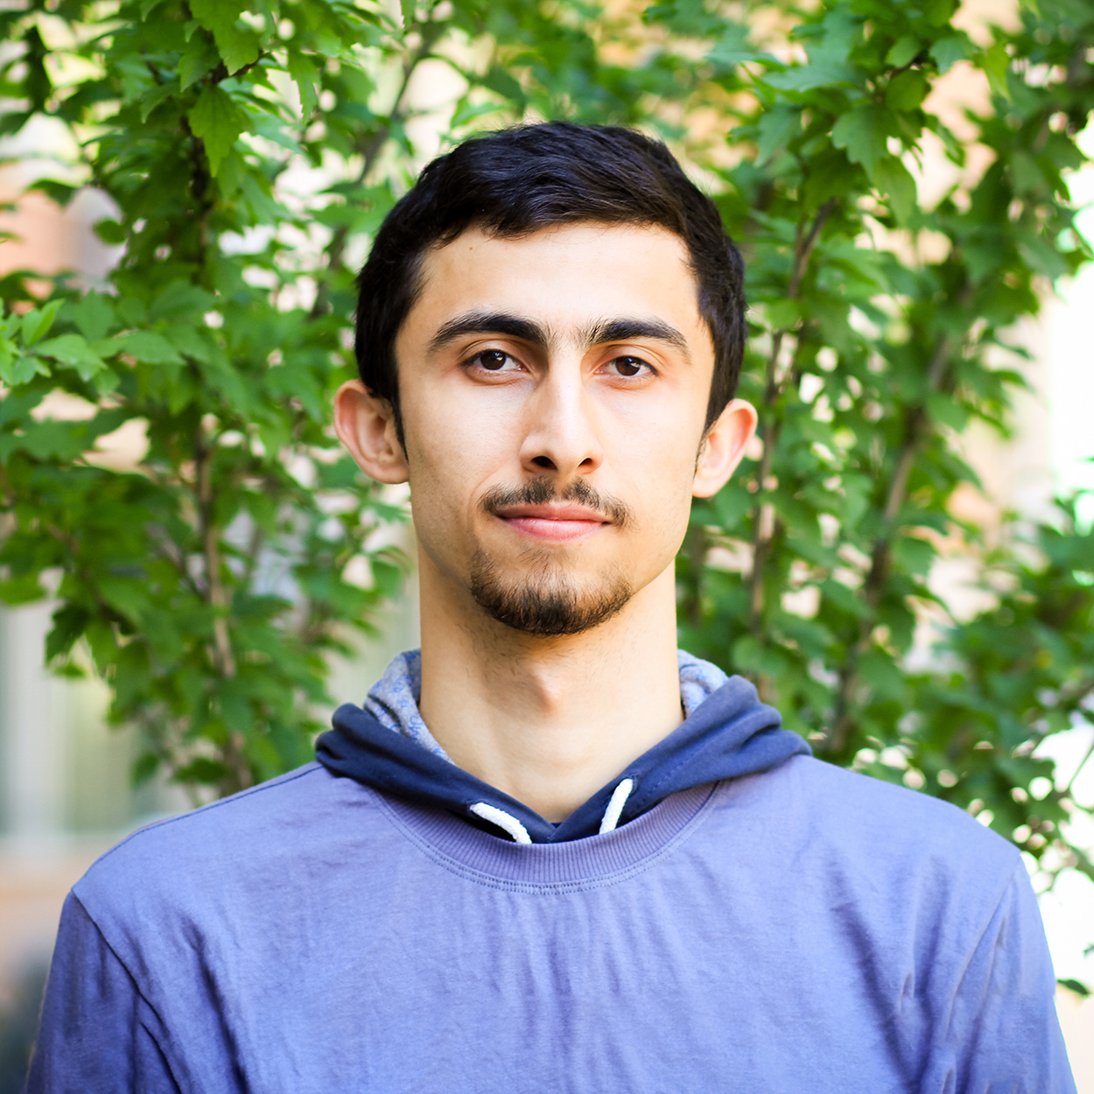

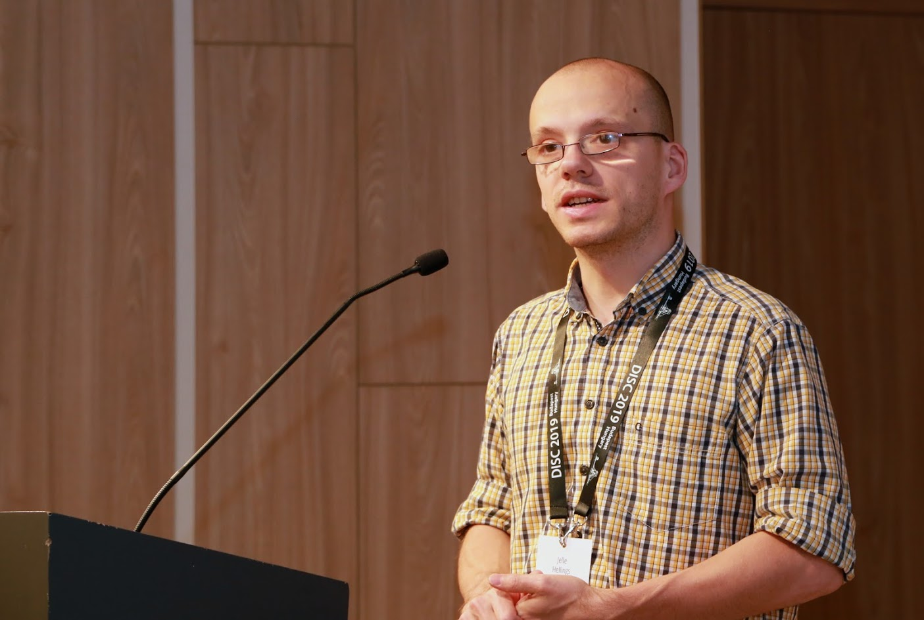


Building High Throughput Permissioned Blockchain Fabrics: Challenges and Opportunities
Suyash Gupta
Jelle Hellings
Sajjad Rahnama
Mohammad Sadoghi
Exploratory Systems Lab
University of California Davis

Slide 2




At the core of any Blockchain application is a Byzantine Fault-Tolerant (BFT) consensus protocol.
OK
OK
Order Txn
OK

Slide 3
Practical Byzantine Fault-Tolerance (PBFT) [OSDI’99]
First practical Byzantine Fault-Tolerant Protocol.
Tolerates up to f failures in a system of 3f+1 replicas
Requires three phases of which two necessitate quadratic communication complexity.
Safety is always guaranteed and Liveness is guaranteed in periods of partial synchrony.

Slide 4
PBFT Civil Executions
Client
T
Primary
Replica 1
Replica 2
Byzantine
Replica
Client
Request
Pre-Prepare
O(n)
Prepare
O(n²)
Commit
O(n²)
Reply
Execute

Slide 5
PBFT Uncivil Execution: Primary Failure (View Change)
Got VC message from Majority?
New Primary
Replica 1
Replica 2
Byzantine Primary
View Change Message
New View Message
Enter New View

Slide 6
Speculative Byzantine Fault Tolerance (Zyzzyva)
[SOSP’07]
Speculation to achieve consensus in a single phase.
Under no failures, it only requires linear communication complexity.
Requires good clients, for ensuring same order across the replicas.
Clients need matching responses from all the 3f+1 replicas.
Just one crash failure is sufficient to severely impact throughput.
Recently, proven unsafe!

Slide 7
Zyzzyva Civil Executions
Client needs
3f+1 responses
Client
T
Primary
Replica 1
Replica 2
Replica 3
Client
Request
Pre-prepare
Reply
Speculative Execution

Slide 8
Zyzzyva under Failure of one Non-Primary Replica
Client
Timeouts
Client
T
Primary
Replica 1
Replica 2
Byzantine Replica
Client
Request
Pre-prepare
Reply
Commit
Certificate
Certificate
Reply
On client timeout → switches to slow-path.

Slide 9
SBFT: A Scalable and Decentralized Trust Infrastructure
[DSN’19]
A safe alternate to Zyzzyva.
Employs threshold signatures to linearize consensus → Splits each O(n²) phase of PBFT into two linear phases.
Requires twin-paths → fast-path and slow-path.
Introduces notion of collectors and executors.

Slide 10
SBFT Civil Execution
Client
Primary
Replica
Collector
Executor
Client Request
Pre-prepare
Sign-share
Commit-Proof
Sign-state
Execute-Proof
Either no failures or c+1 crash failures for c > 0 collectors if n = 3f+2c+1

Slide 11
Hotstuff: BFT Consensus in the Lens of Blockchain
[PODC’19]
Splits each O(n²) phase of PBFT into two linear phases.
Advocates leaderless consensus → Frequent primary replacement.
Employs threshold signatures to linearize consensus → enforces sequential processing.
Two versions:
Basic Hotstuff: Primary switched at the end of each consensus.
Chained Hotstuff: Employs pipelining to ensure each phase run by a distinct primary.

Slide 12
Hotstuff Protocol
Primary
Replica 1
Replica 2
Byzantine
Replica
View
change
Proposal
Prepare
vote
Pre-commit
Message
Pre-commit
Vote
Commit
Message
Commit
Vote
Decide
Prepare
Phase
Pre-Commit
Phase
Commit Phase

Slide 13
Other Proposed Byzantine-Fault Tolerant Designs
System consisting of n >> 3f+1.
Q/U [SOSP’05] expects 5f+1 replicas.
Use of trusted components to prevent primary equivocation.
AHL [SIGMOD’19]

Slide 14
Novel Byzantine Fault-Tolerant Protocols

Slide 15
Speculative Execution
Proof-of-Execution (PoE)
Three-phase Linear protocol
Out-of-Order Message Processing
No dependence on clients or trusted component.
No reliance on a twin-path design.

Slide 16
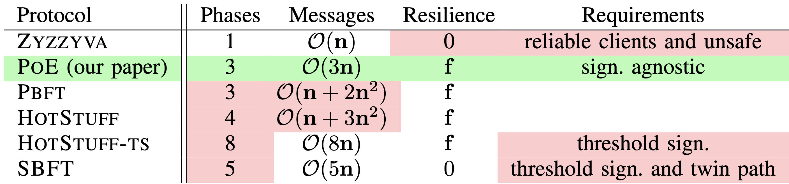
PoE vs Other Protocols

Slide 17
Proof-of-Execution (PoE)
Client
T
Primary
Replica 1
Replica 2
Byzantine
Replica
Client
Request
Pre-Prepare
Prepare
Certify
Reply
Execute
n = 4 replicas and f <= 1

Slide 18
PoE View Change Protocol
New Primary
Replica 1
Replica 2
Byzantine Primary
View Change Request
Join after Receiving
f+1 VC requests
New View
Propose
Enter
New View

Slide 19
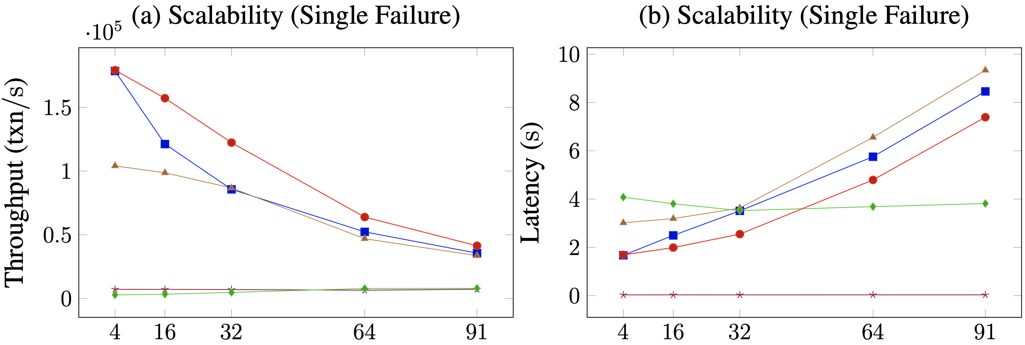
PoE Scalability under Single Failure

Slide 20
Resilient Concurrency Control (RCC) Paradigm
Democracy → Give all the replicas the power to be the primary.
Parallelism → Run multiple parallel instances of a BFT protocol.
Decentralization → Always there will be a set of ordered client requests.

Slide 21
RCC Defense
Why should BFT protocols rely on just one primary replica?
Malicious primary can throttle the system throughput.
Malicious primary requires replacemenat → fall in throughput.

Slide 22
Resilient Concurrency Control Paradigm
Parallelism
Ordering
Execution
BFT protocol
Run z parallel BFT
instances.
Create a global order
of all the requests.
Execute the requests
in a global order.
Number of
Instances (z)
RCC can employ several BFT protocols: PBFT, Zyzzyva, SBFT and PoE.

Slide 23
Client
T
1
Primary
Replica
2
1
Replica
2
Client
T
Primary
Replica
1
2
Byzantine
Replica
1
2
Request
Pre-Prepare
Prepare
Commit
Reply
RCC using PBFT with 2 parallel instances on each replica

Slide 24
Colluding Primaries
Multiple malicious primaries can prevent liveness!
Solution → Optimistic Recovery through State Exchange.
Good Replicas
|A| = f
Good Replica
|C| = 1
Good Replicas
|B| = f
m₁
m₂
P₁
|M| = f
P₂
Other f-2
Malicious Replicas

Slide 25
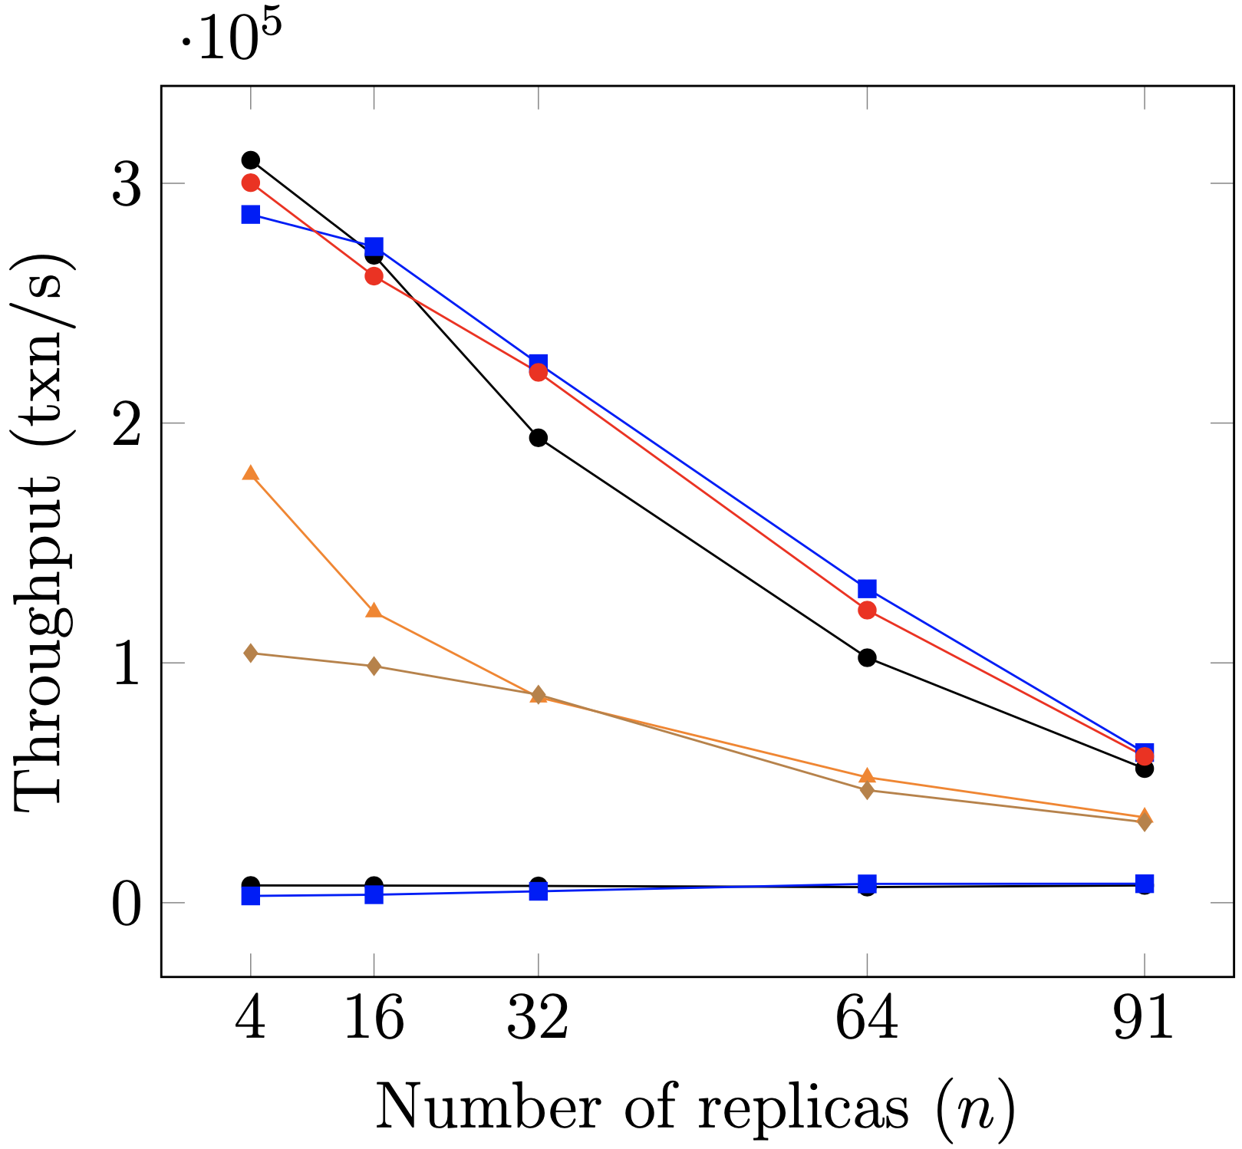
Scalability
26x
Single Failure Experiments

Slide 26
Global Scale Resilient Blockchain Fabric
Traditional BFT protocols do not scale to geographically large distances.
Blockchain requires decentralization → replicas can be far apart → expensive communication!
The underlying BFT consensus protocol should be topology-aware.
Proceedings of the VLDB Endowment 2020.

Slide 27
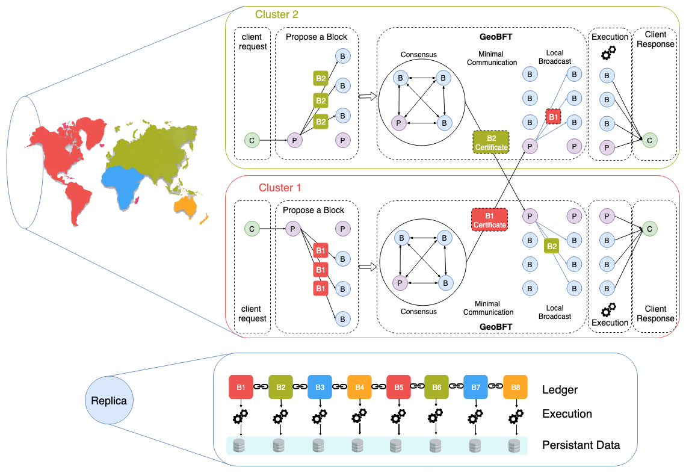
Vision Geo-Scale Byzantine Fault-Tolerance

Slide 28
GeoBFT Protocol
GeoBFT is a topology-aware protocol, which groups replicas into clusters. Each cluster runs the PBFT consensus protocol, in parallel and independently.
Local Replication
Inter-cluster Sharing
Ordering and Execution
Each cluster runs PBFT to select, locally replicate, and certify a client request.
Primary at each cluster shares the certified client request with other clusters.
Order the certified requests, execute them, and inform local clients.

Slide 29
Client
P_{C1}
Local PBFT Consensus on T₁
R_{1,1}
Cluster 1
C₁
R_{1,2}
R_{1,3}
Client
P_{C2}
Local PBFT Consensus on T₁
Cluster 2
C₂
R_{2,1}
R_{2,2}
R_{2,3}
Local Request
Local Replication
Global
Sharing
Local
Sharing
Reply

Slide 30
GeoBFT Takeaways
To ensure common ordering → linear communication among the clusters is required.
Primary replica at each cluster sends a secure certificate to f+1 replicas of every other cluster.
Certificates guarantee common order for execution.
If primary sends invalid certificates → will be detected as malicious.

Slide 31
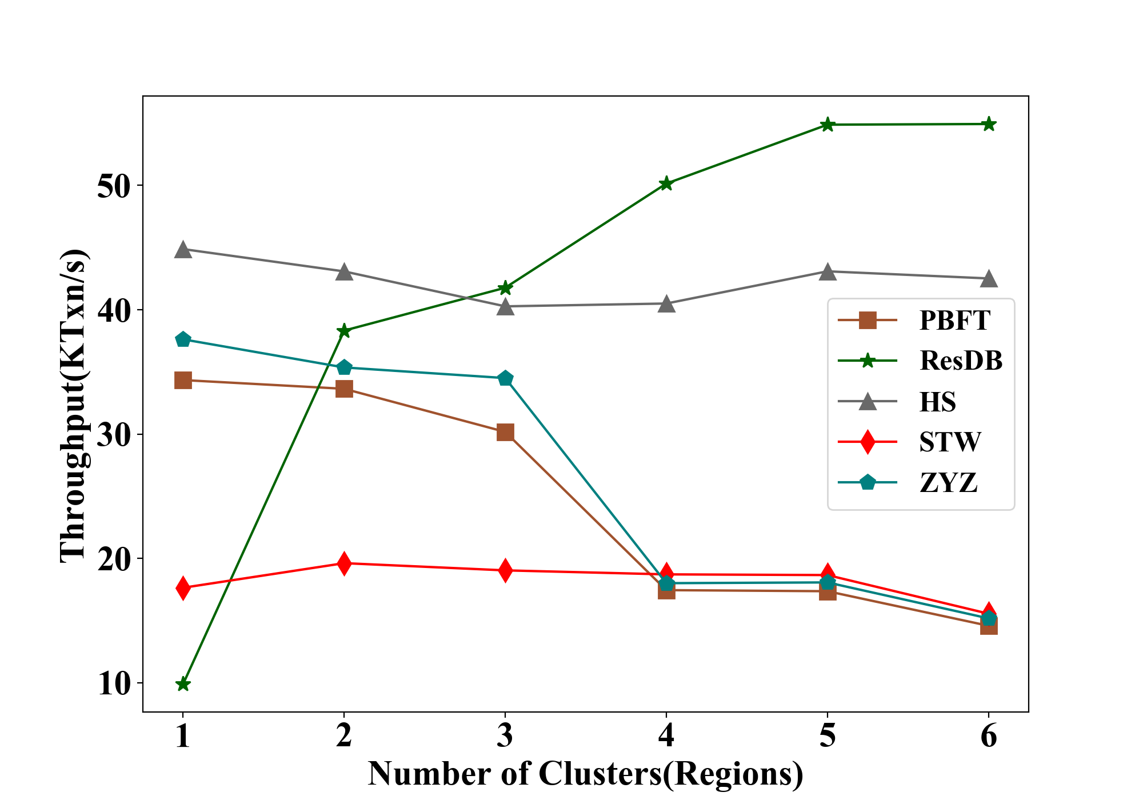
GeoBFT Scalability

Slide 32
Permissioned Blockchain Through the Looking Glass: Architectural and Implementation Lessons Learned
Visit at: https://resilientdb.com/
*Proceedings of the 40th IEEE ICDCS 2020.

Slide 33
Why Should You Chose ResilientDB?
Bitcoin and Ethereum offer low throughputs of 10 txns/s.
Existing Permissioned Blockchain Databases still have low throughputs (20K txns/s).
Prior works blame BFT consensus as expensive.
System Design is mostly overlooked.
ResilientDB adopts well-researched database and system practices.

Slide 34
Dissecting Existing Permissioned Blockchains
Single-threaded Monolithic Design
Successive Phases of Consensus
Integrated Ordering and Execution
Strict Ordering
Off-Chain Memory Management
Expensive Cryptographic Practices

Slide 35
Can a well-crafted system based on a classical BFT protocol outperform a modern protocol?

Slide 36
ResilientDB Architecture
SECURE
LAYER
EXECUTION LAYER
THREADS
SIGNING
TOOLKIT
QUEUES
NET WORK
HASHING
TOOLKIT
BFT CONSENSUS
STORAGE LAYER
METADATA
BLOCKCHAIN

Slide 37
ResilientDB Multi-Threaded Deep Pipeline
Network
Network
Client
Requests
Input
Batch Creation
Output
Message from
Clients and Replicas
Prepare
& Commit
Message to
Replicas and Clients
Worker
Execute
Checkpoint
37

Slide 38
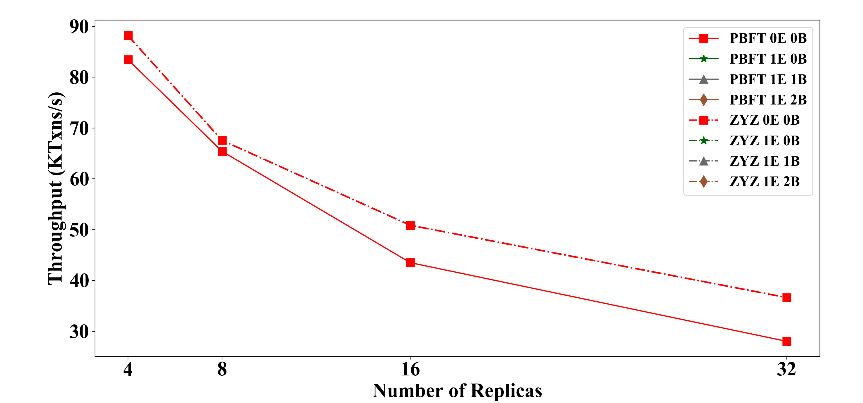
Insight 1: Multi-Threaded pipeline Gains
Parallelizing and Pipelining tasks across worker, execution (E) and batch-threads (B).

Slide 39
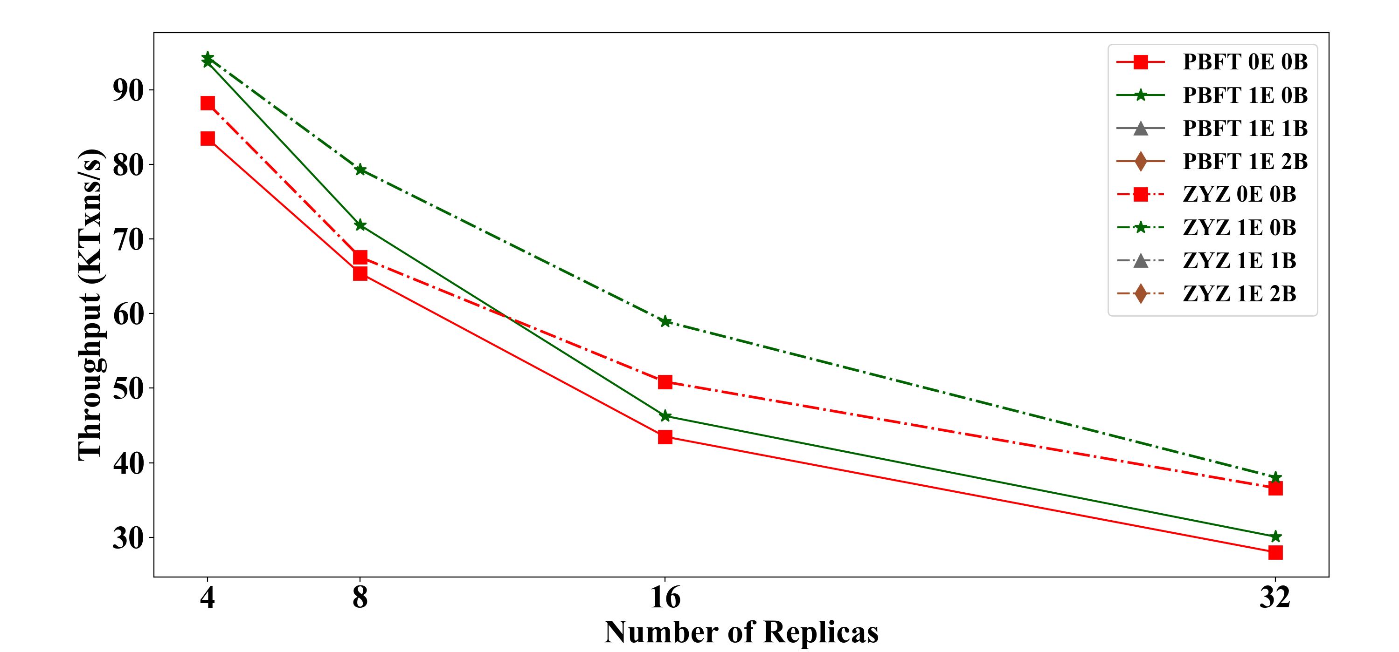
Insight 1: Multi-Threaded pipeline Gains
Parallelizing and Pipelining tasks across worker, execution (E) and batch-threads (B).

Slide 40
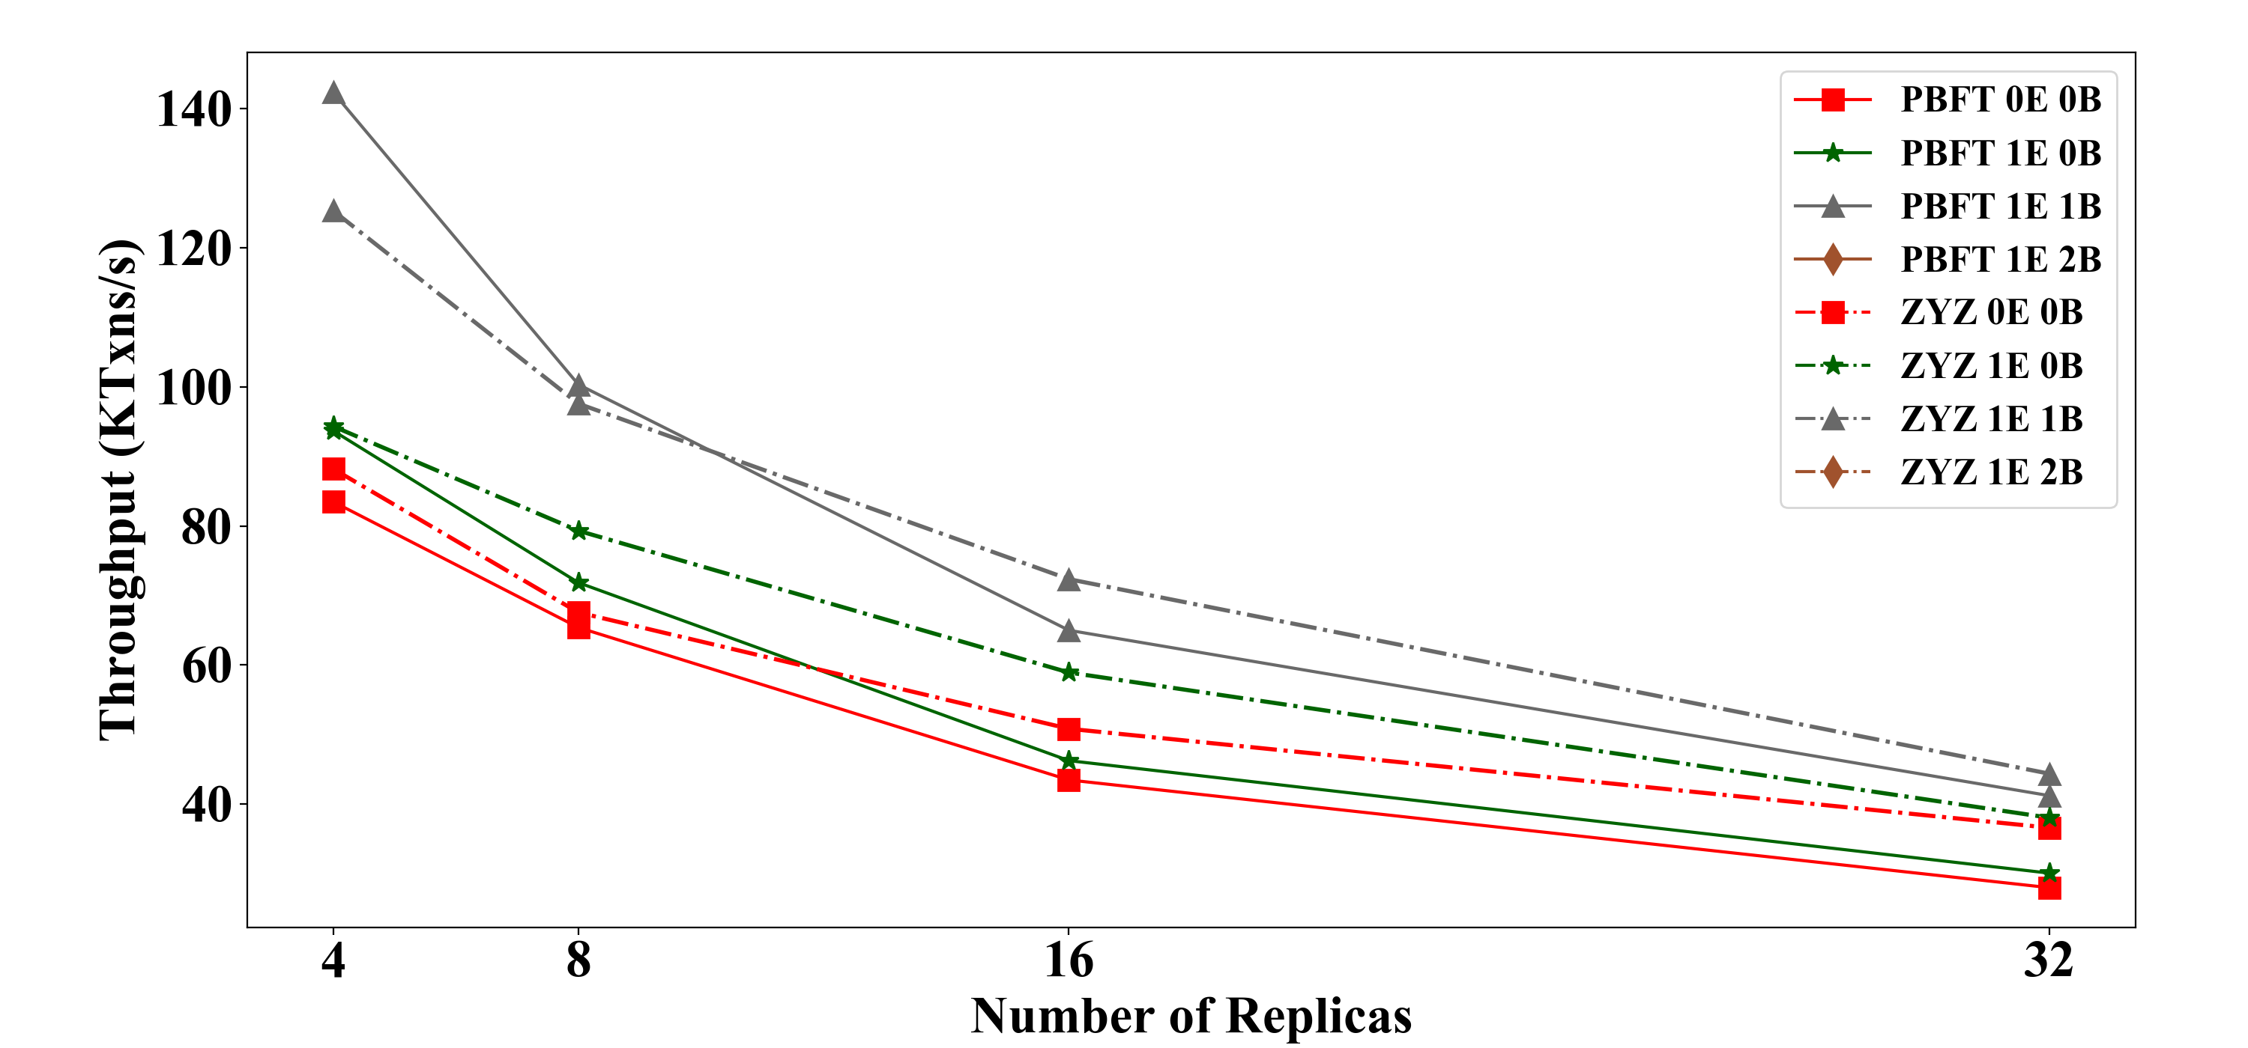
Insight 1: Multi-Threaded pipeline Gains
Parallelizing and Pipelining tasks across worker, execution (E) and batch-threads (B).

Slide 41
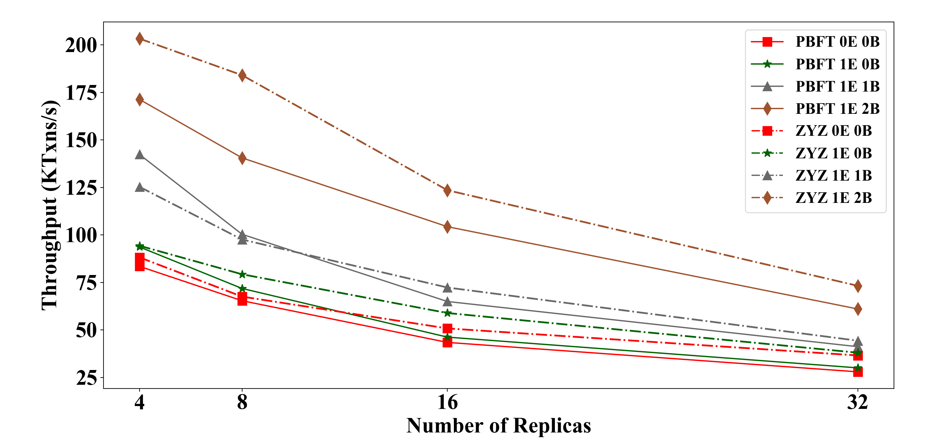
Insight 1: Multi-Threaded pipeline Gains
Parallelizing and Pipelining tasks across worker, execution (E) and batch-threads (B).

Slide 42
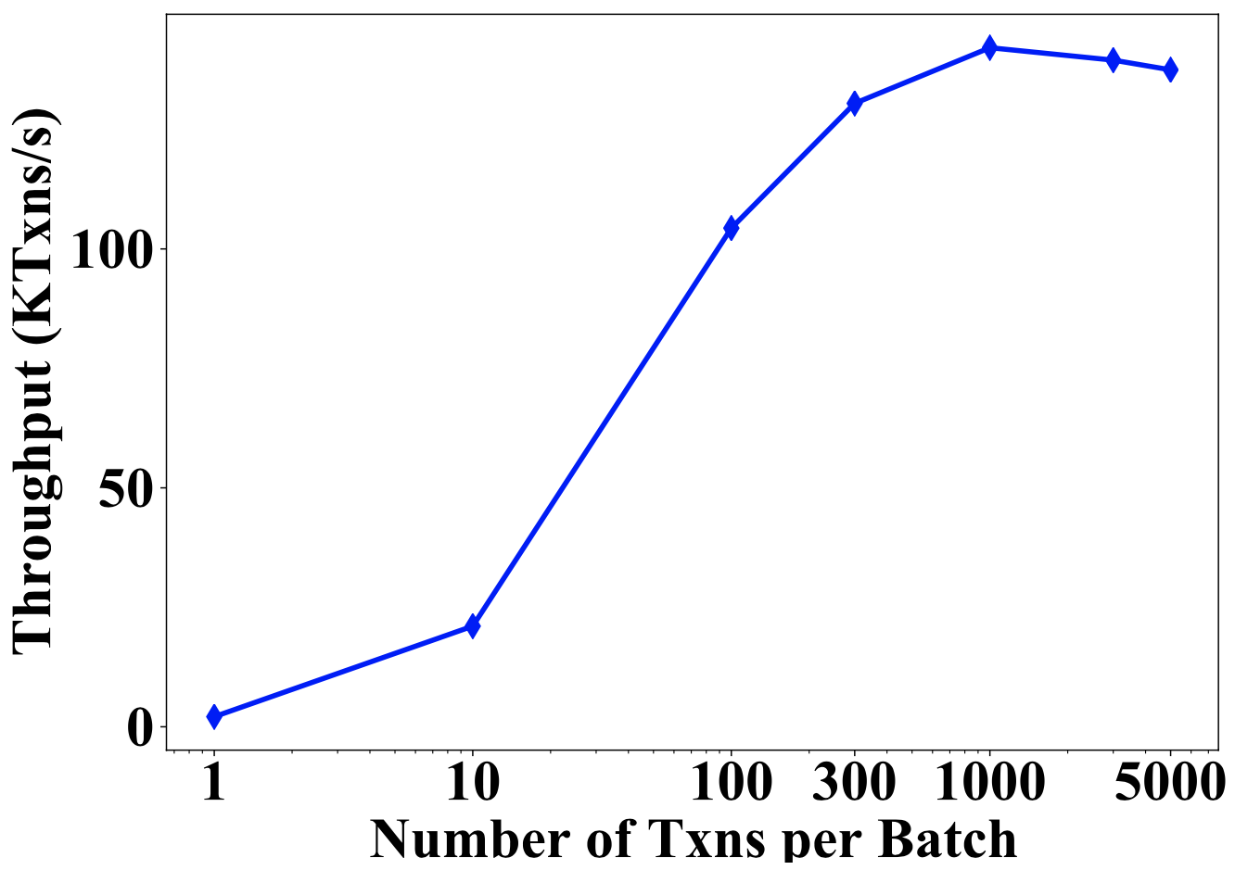
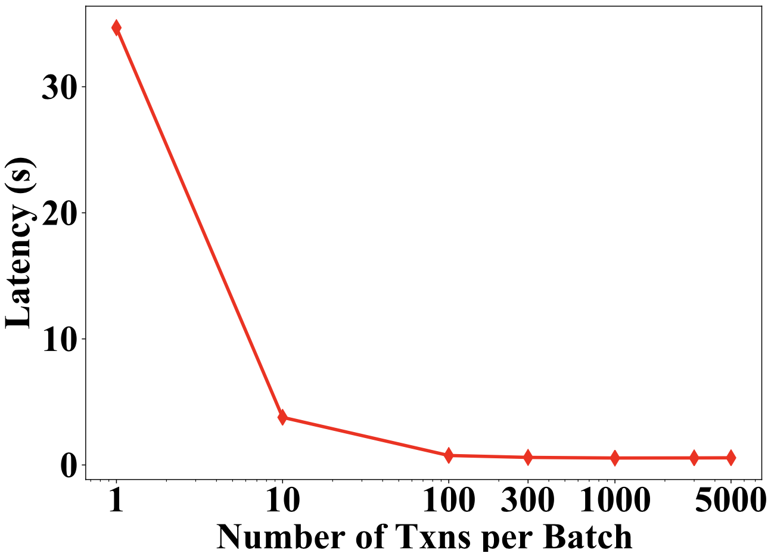
Insight 2: Optimal Batching Gains
More transactions batched together → increase in throughput
→reduced phases of consensus.

Slide 43
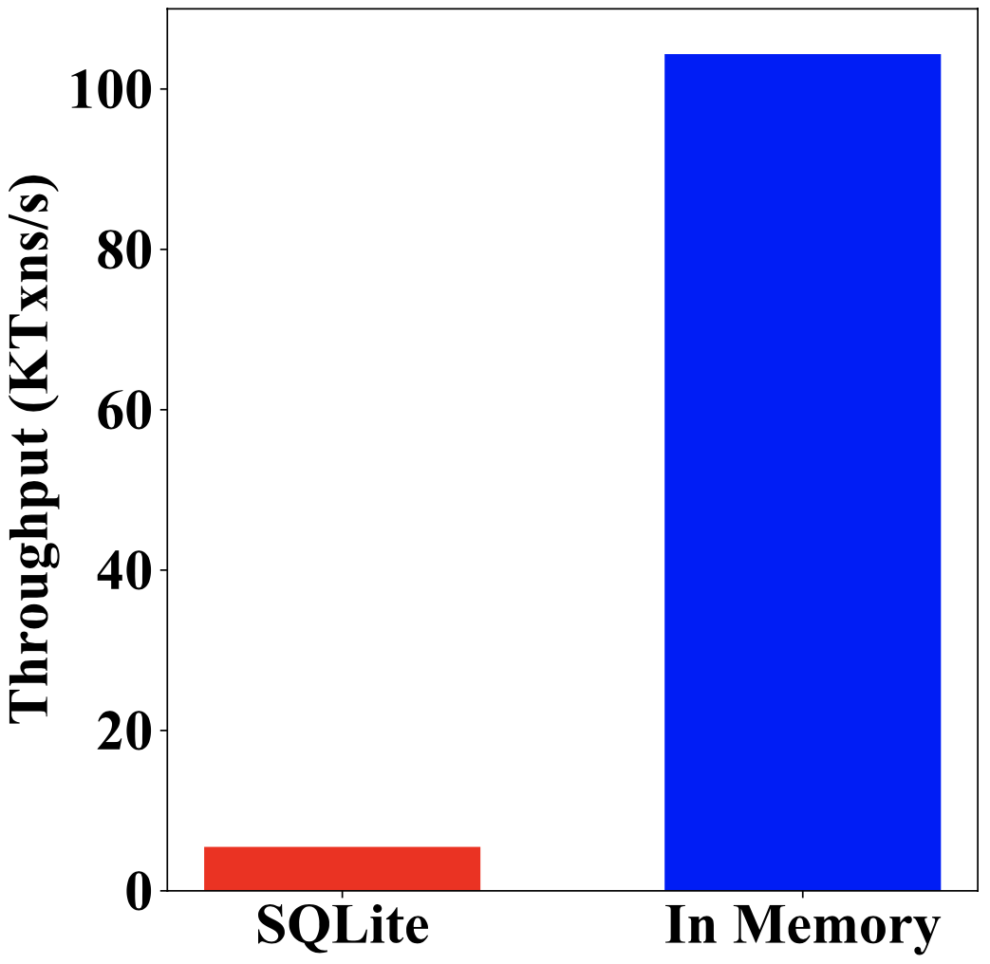
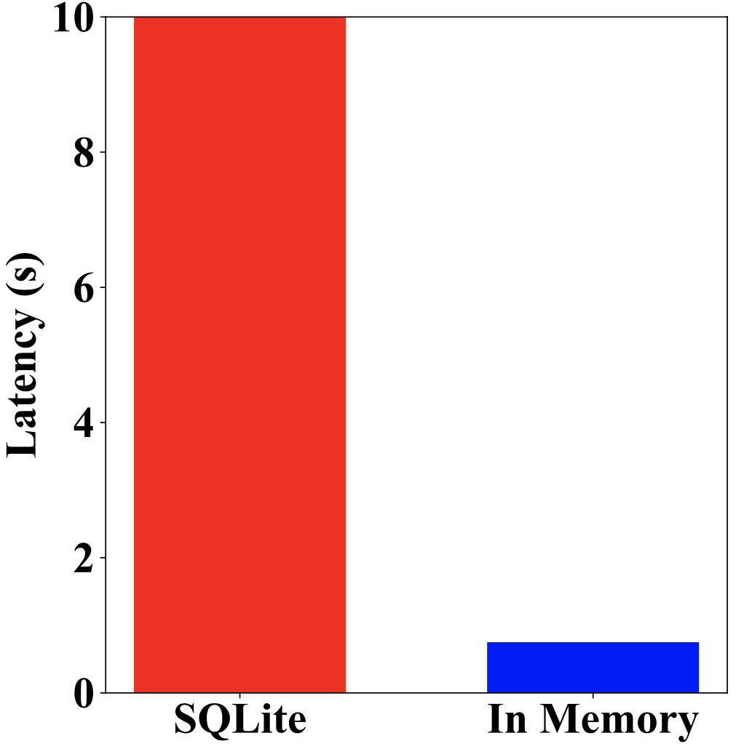
Insight 3: Memory Storage Gains
In-memory blockchain storage → reduces access cost.

Slide 44
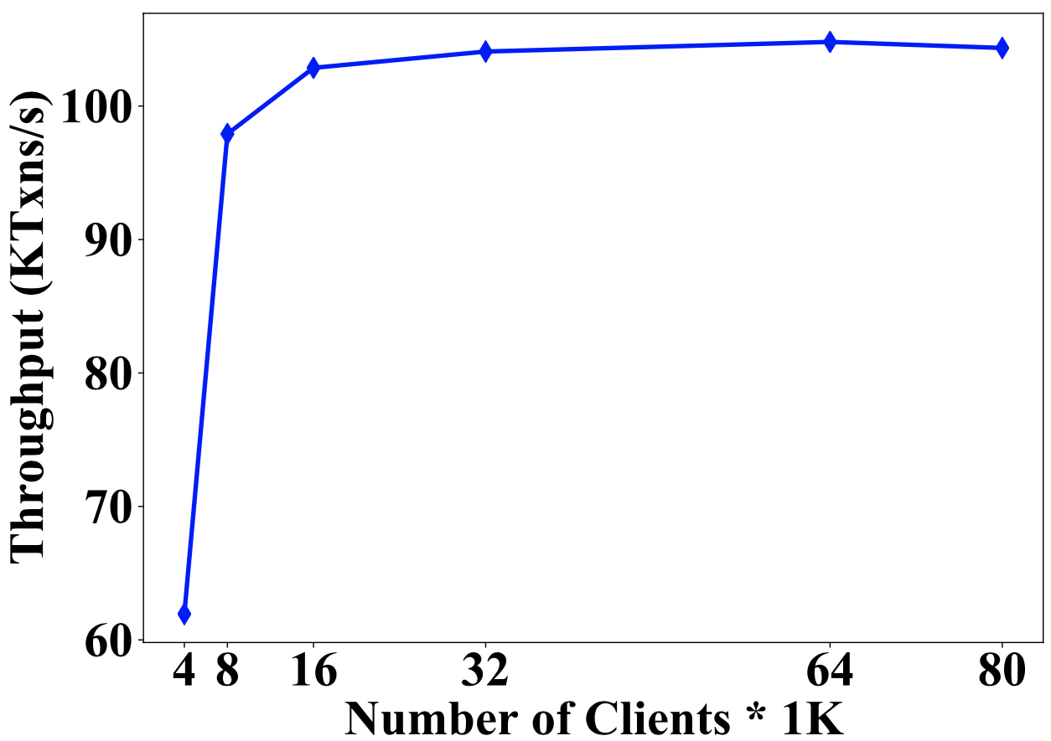
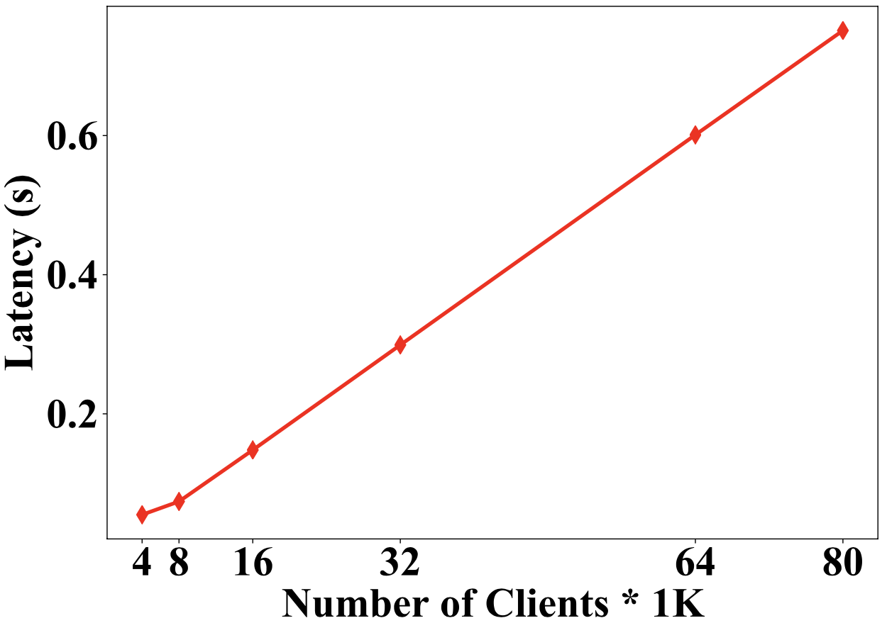
Insight 4: Number of Clients
Too many clients → increases average latency.

Slide 45
ResilientDB: Hands On
Visit at: https://github.com/resilientdb/resilientdb

Slide 46
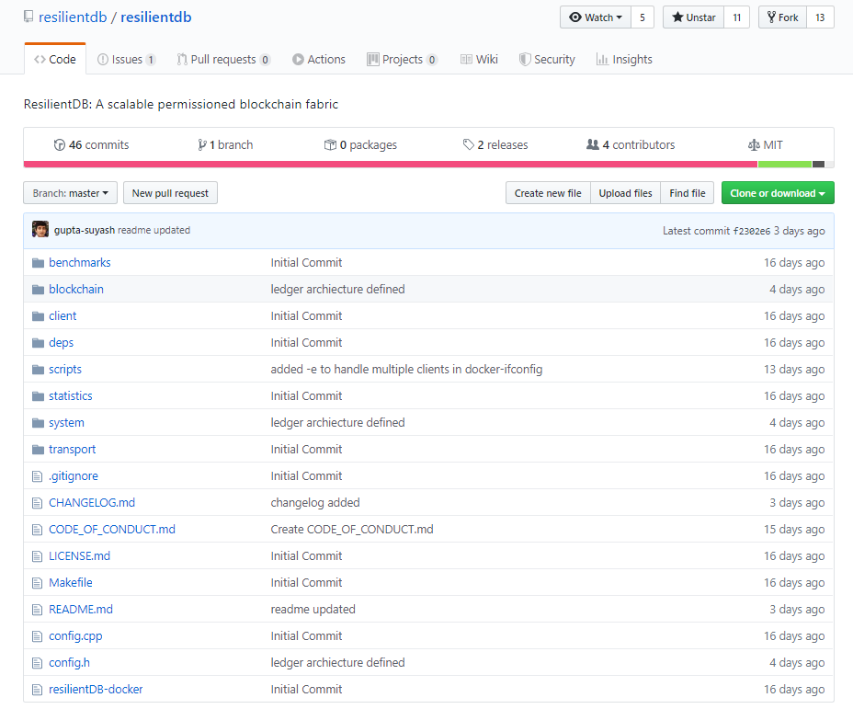
How to Run ResilientDB?

Slide 47
How to Run ResilientDB?
Go to https://github.com/resilientdb/resilientdb and Fork it!
Install Docker-CE and Docker-Compose (Links on git)
Use the Script ”resilientDB-docker” as following:
./resilientDB-docker --clients=1 --replicas=4
./resilientDB-docker -d [default 4 replicas and 1 client]
Result will be printed on STDOUT and stored in res.out file.

Slide 48
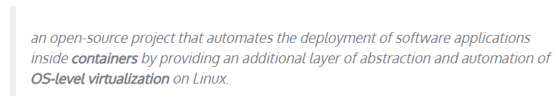
Docker CE
What is Docker?
Run a distributed program on one machine
Simulate with lightweight virtual machines

Slide 49
How to Run ResilientDB?
Go to https://github.com/resilientdb/resilientdb and Fork it!
Install Docker-CE and Docker-Compose (Links on git)
Use the Script ”resilientDB-docker” as following:
./resilientDB-docker --clients=1 --replicas=4
./resilientDB-docker -d [default 4 replicas and 1 client]
Result will be printed on STDOUT and stored in res.out file.

Slide 50
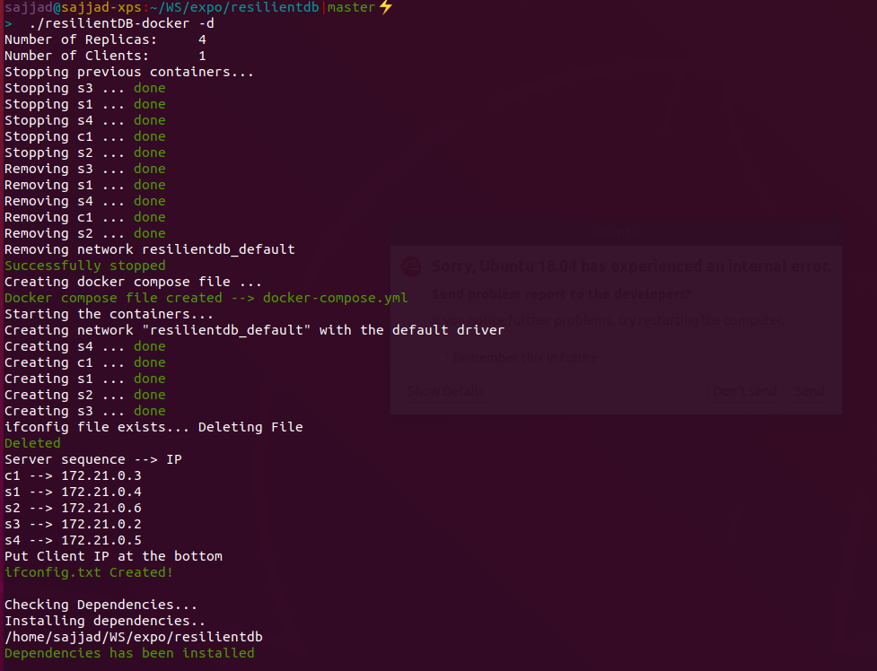
Resilient DB
./resilientDB-docker -d
Remove old Containers
Create new Containers
Create IP address settings
Install dependencies
Compile Code
Run binary files
Gather the results

Slide 51
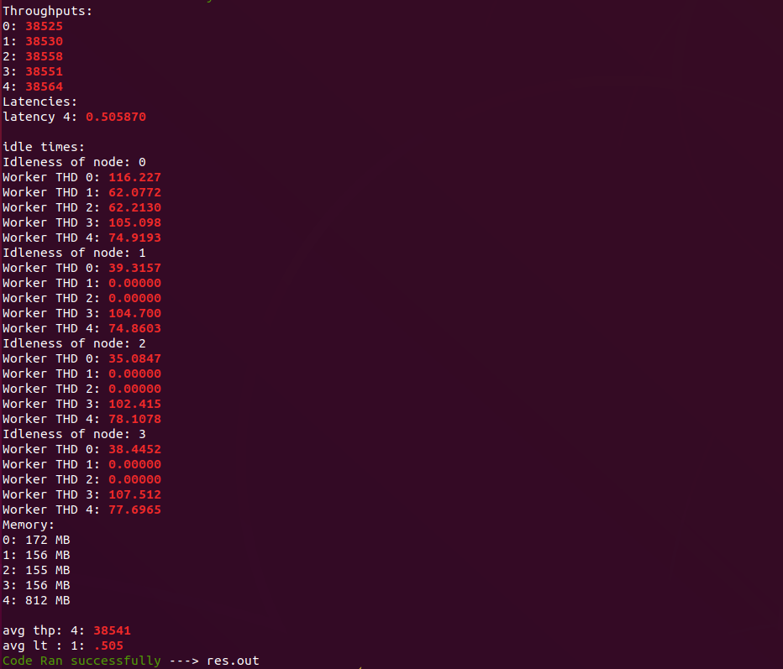
Resilient DB
Throughput
Transaction per second
Average Latency
The from client request to client reply
Working Thread idleness
The time that thread is waiting
WT0: Consensus Messages
WT1 and WT2: Batch Threads
WT3: checkpointing Thread
WT4: Execute Theread

Slide 52
Configuration Parameters to Play
NODE_CNT Total number of replicas, minimum 4, that is, f=1.
THREAD_CNT Total number of threads at primary (at least 5)
CLIENT_NODE_CNT Total number of clients (at least 1).
MAX_TXN_IN_FLIGHT Multiple of Batch Size
DONE_TIMER Amount of time to run the system.
BATCH_THREADS Number of threads at primary to batch client transactions.
BATCH_SIZE Number of transactions in a batch (at least 10)
TXN_PER_CHKPT Frequency at which garbage collection is done.
USE_CRYPTO To switch on and off cryptographic signing of messages.
CRYPTO_METHOD_ED25519 To use ED25519 based digital signatures.
CRYPTO_METHOD_CMAC_AES To use CMAC + AES combination for authentication

Slide 53
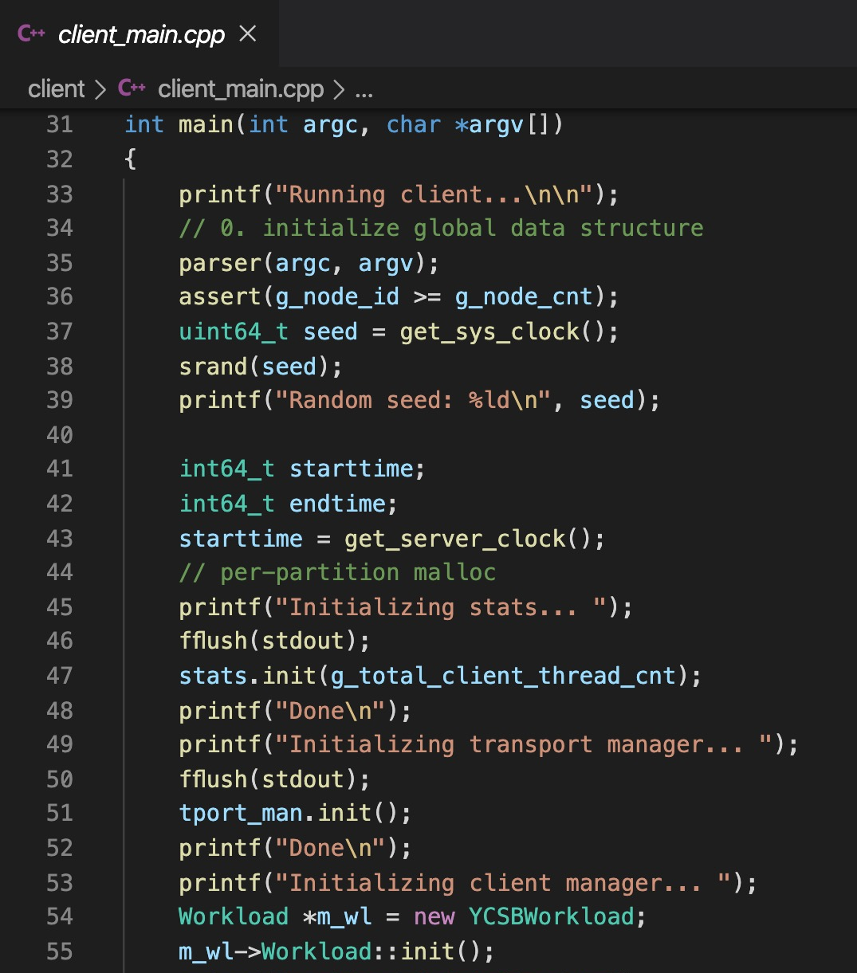
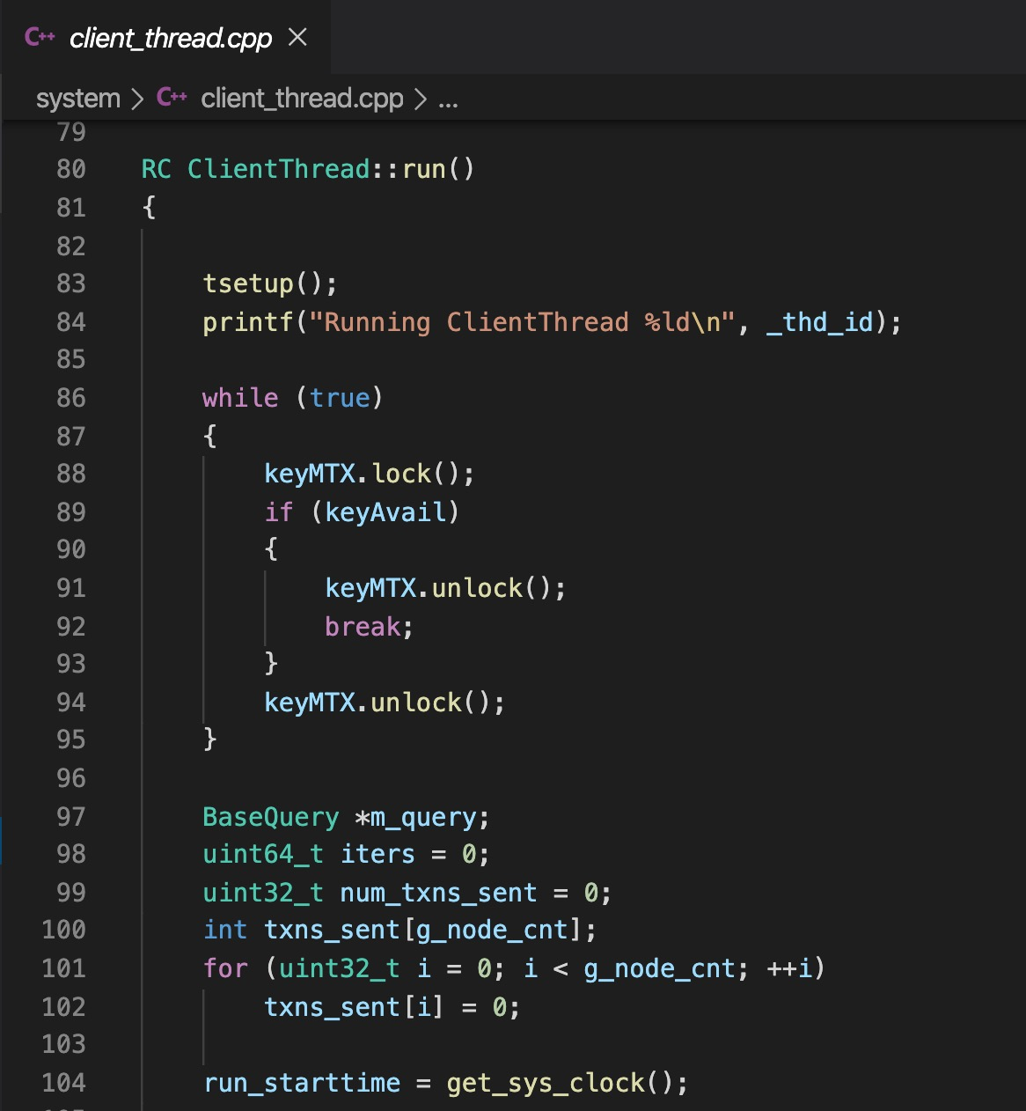
PBFT: Practical Byzantine Fault Tolerance
Main Functions
Client/client_main.cpp
System/client_thread.cpp
System/main.cpp

Slide 54
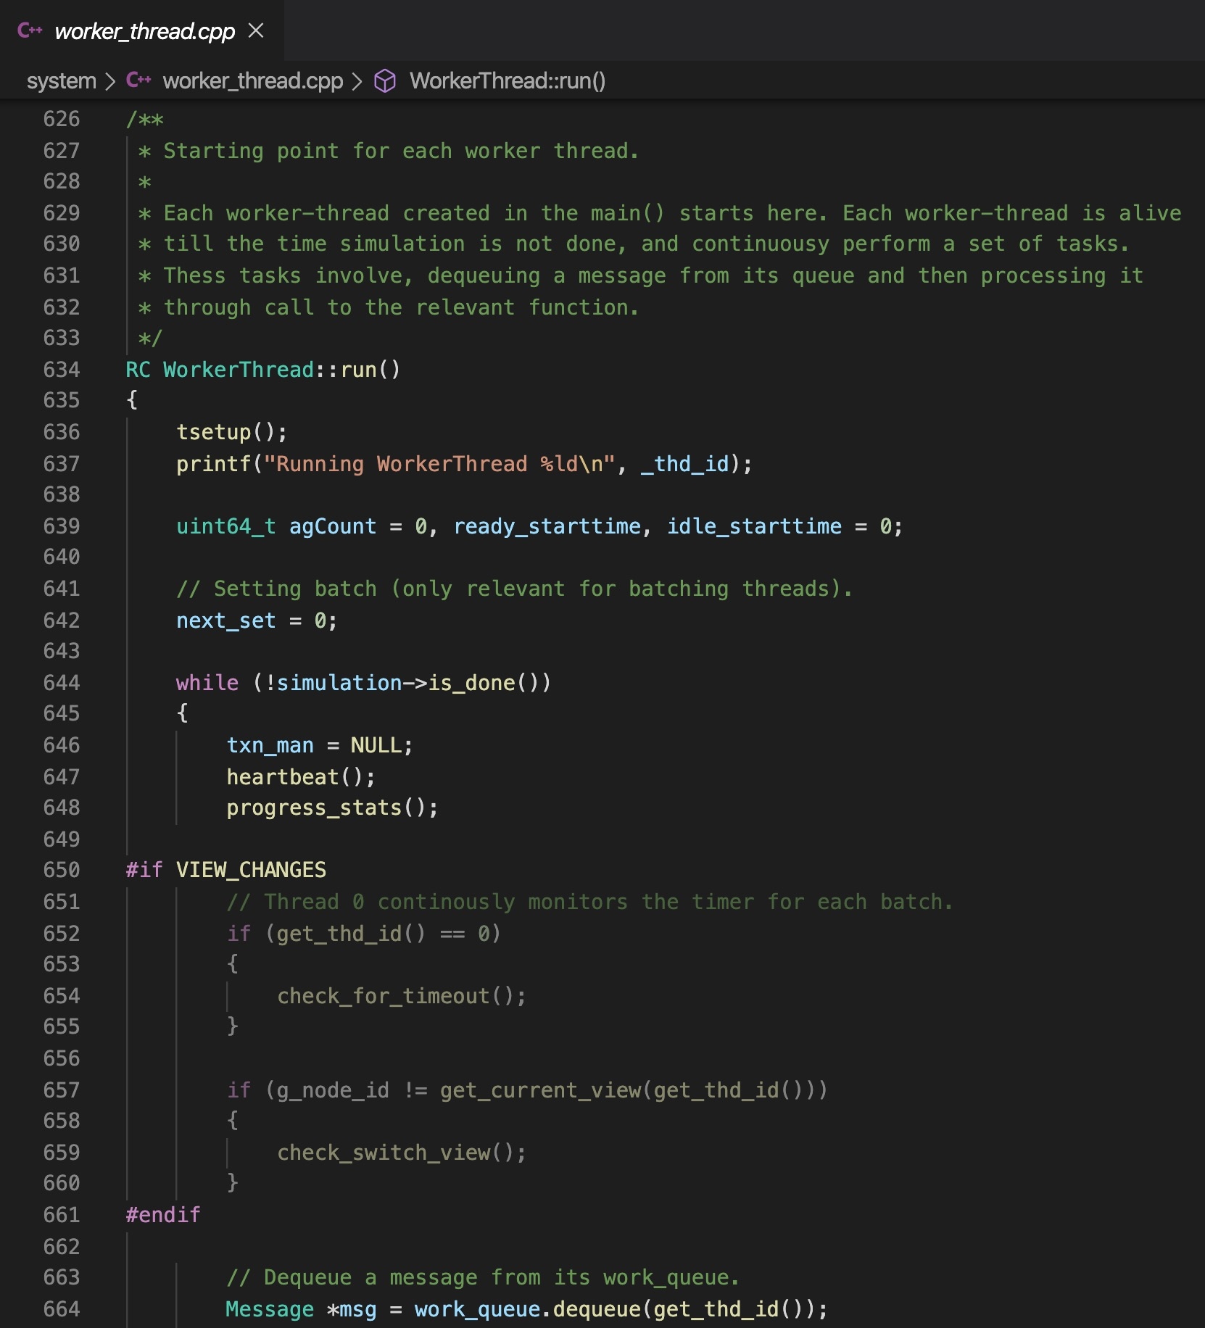
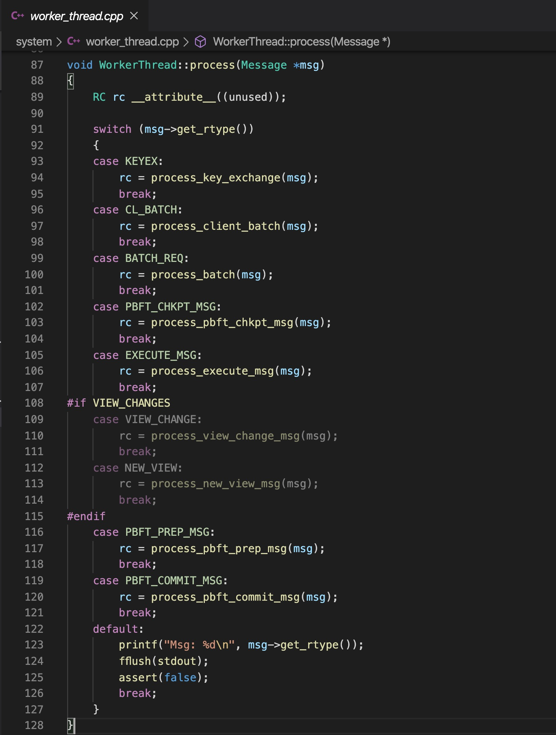
PBFT: Practical Byzantine Fault Tolerance
Process Messages
Transport/message.cpp
System/worker_thread.cpp
System/worker_thread_pbft.cpp
Worker Thread: Run function
Worker Thread: Process function

Slide 55
PBFT Failure-Free Flow
Client
T
Primary
Replica 1
Replica 2
Byzantine
Replica
Client
Request
Pre-Prepare
O(n)
Prepare
O(n²)
Commit
O(n²)
Reply

Slide 56
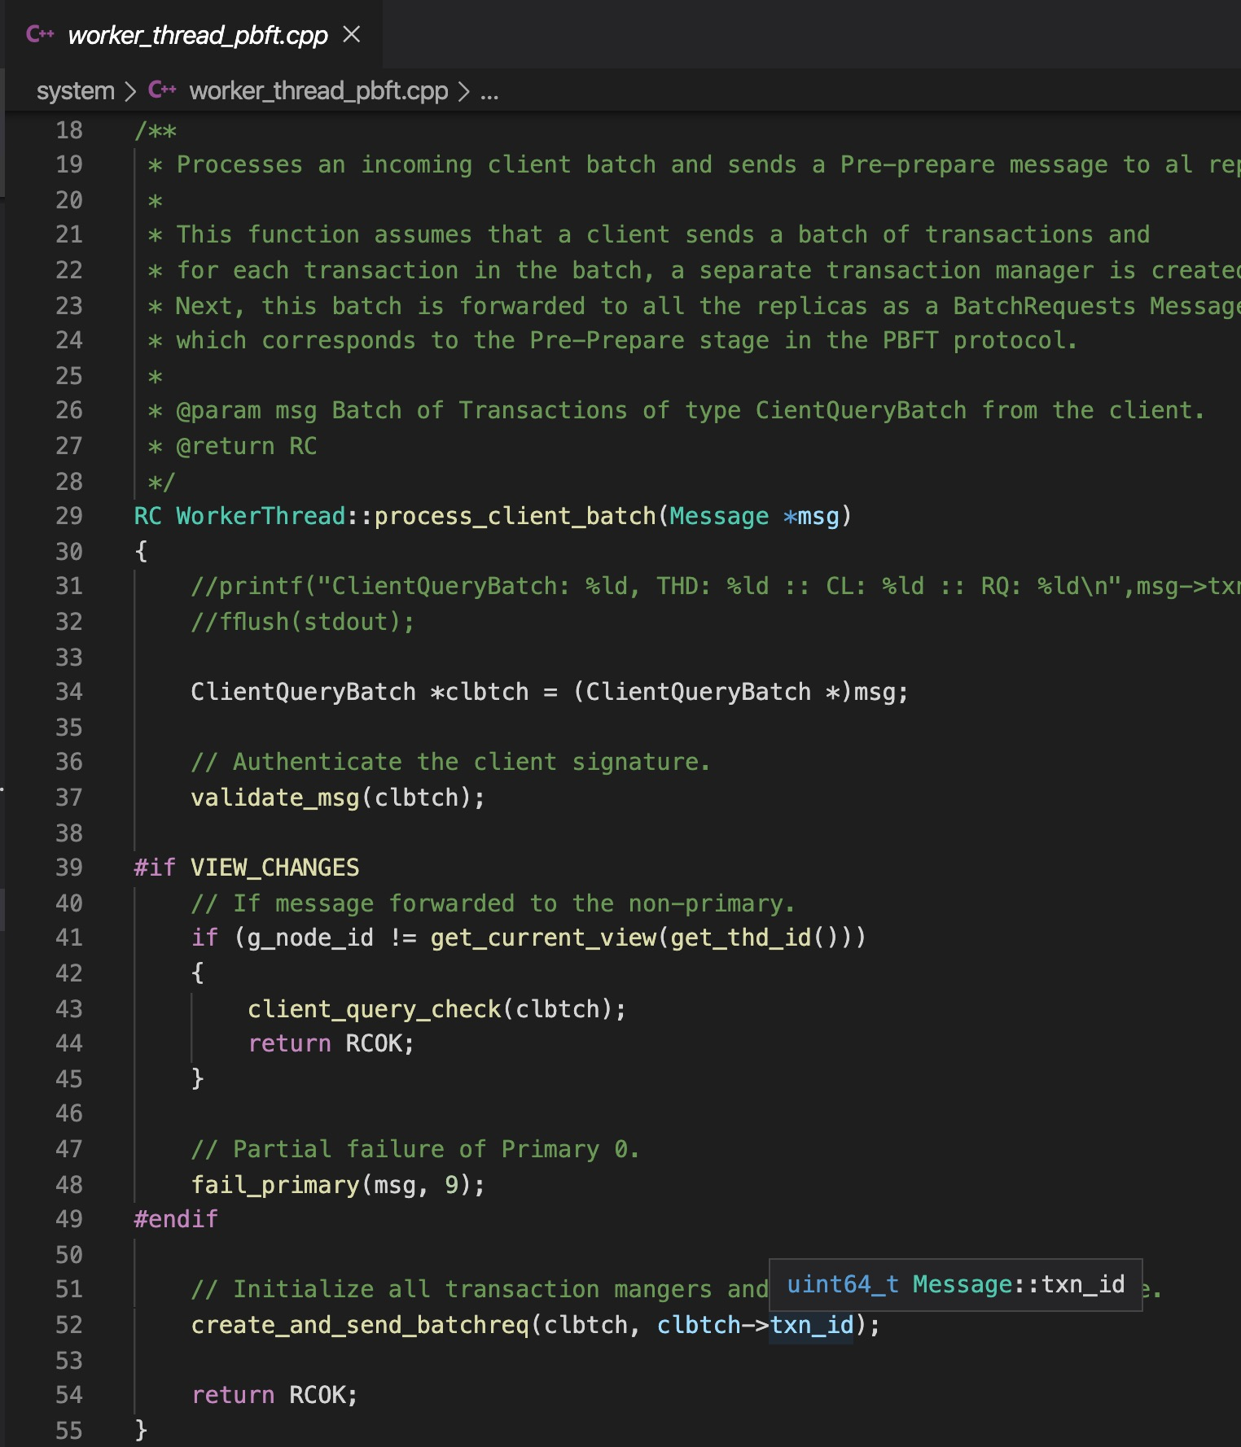
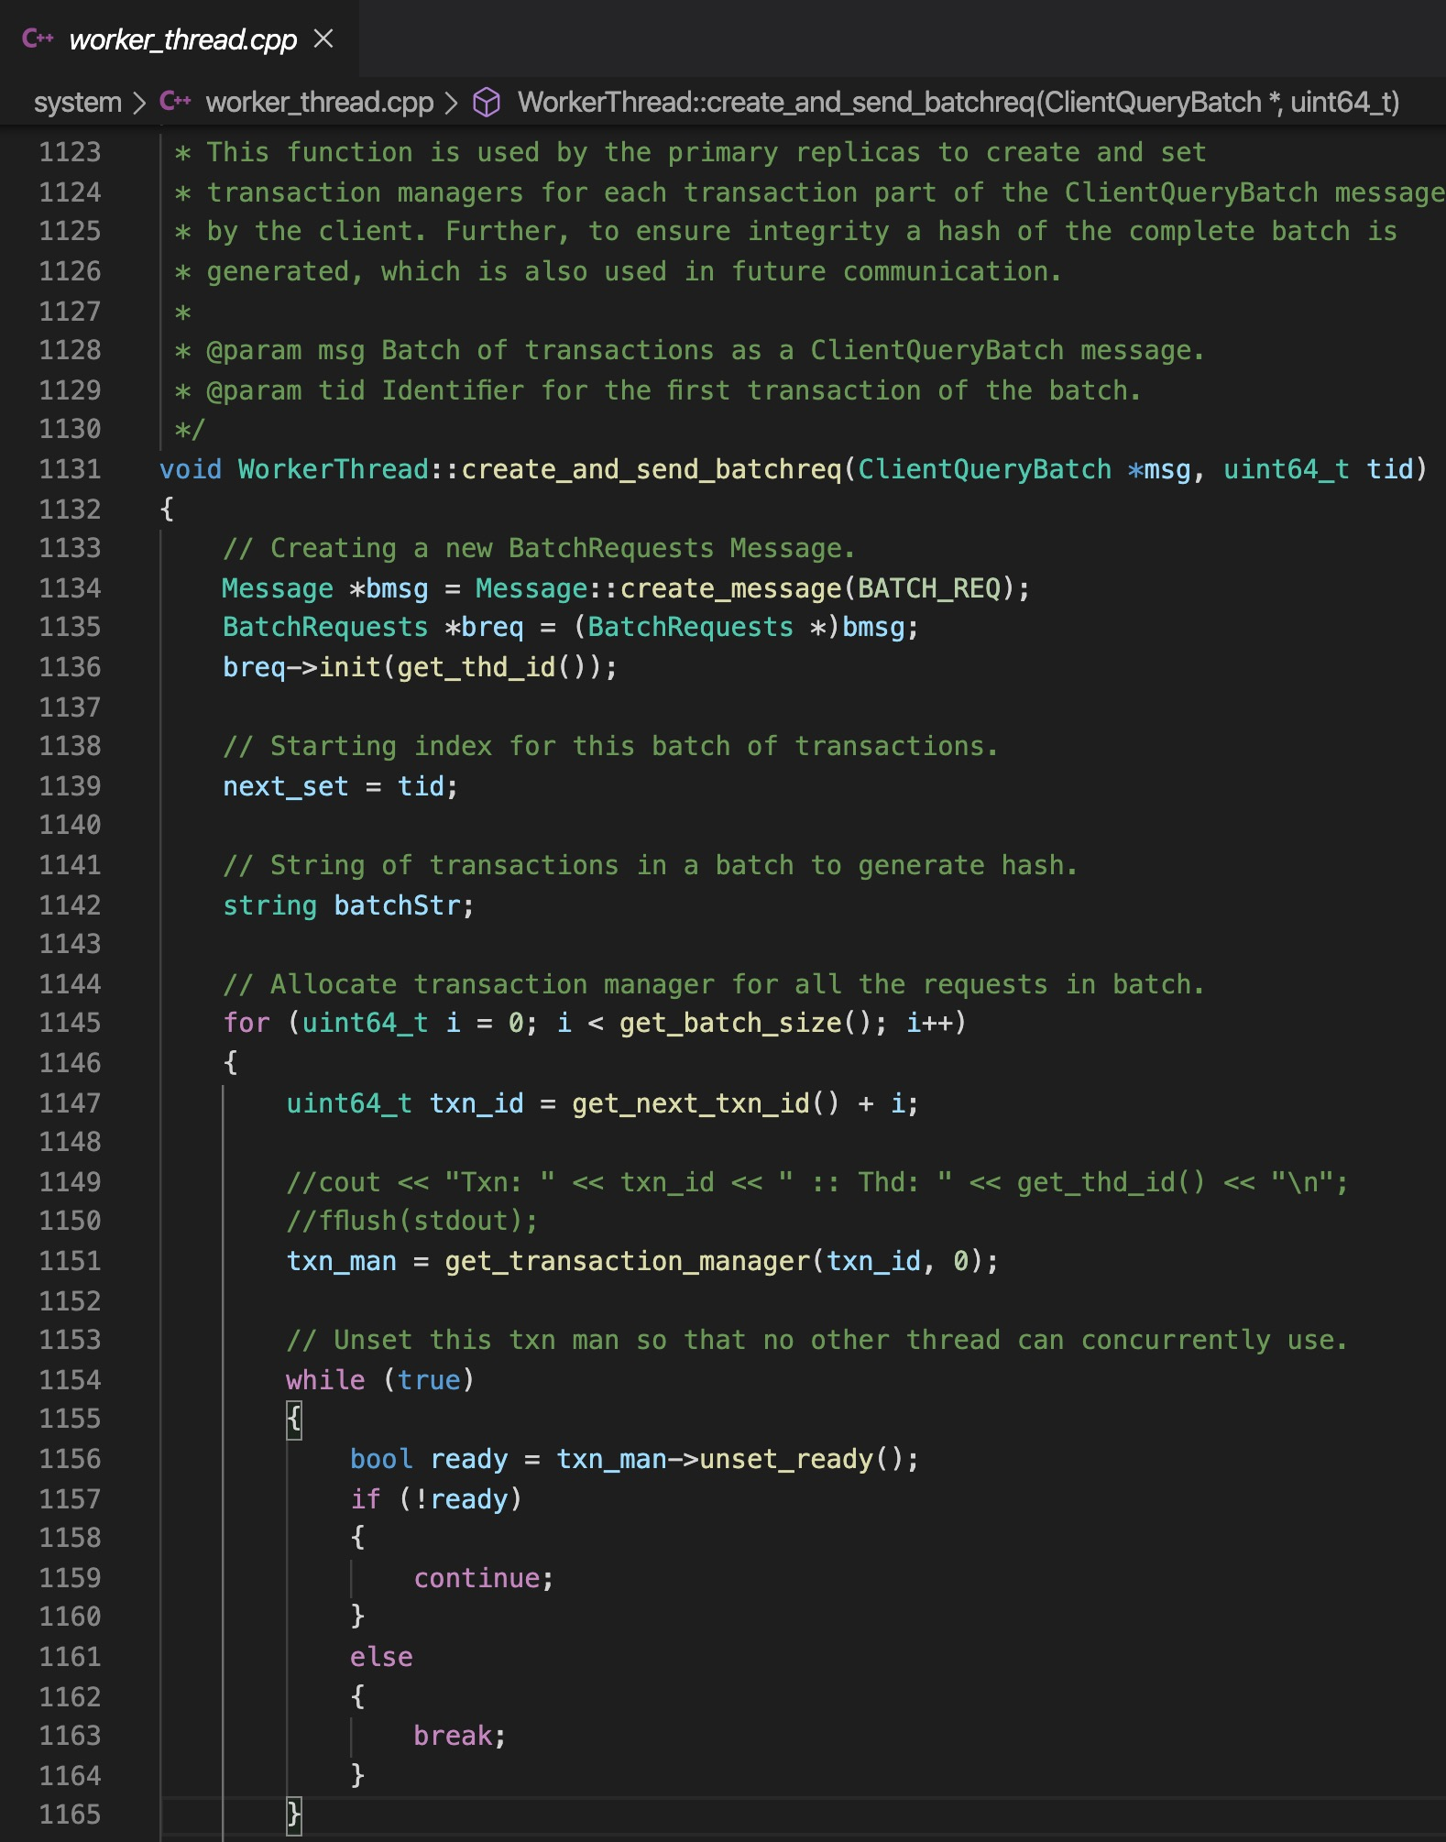
PBFT: Practical Byzantine Fault Tolerance
Process Client Message
System/worker_thread_pbft.cpp
process_client_batch Function
Create and Send Batch Request
create_and_send_batchreq Function
Create Transactions
Create Digest
BatchRequest Class
Pre-Prepare Message

Slide 57
PBFT Failure-Free Flow
Client
T
Primary
Replica 1
Replica 2
Byzantine
Replica
Client
Request
Pre-Prepare
O(n)
Prepare
O(n²)
Commit
O(n²)
Reply

Slide 58
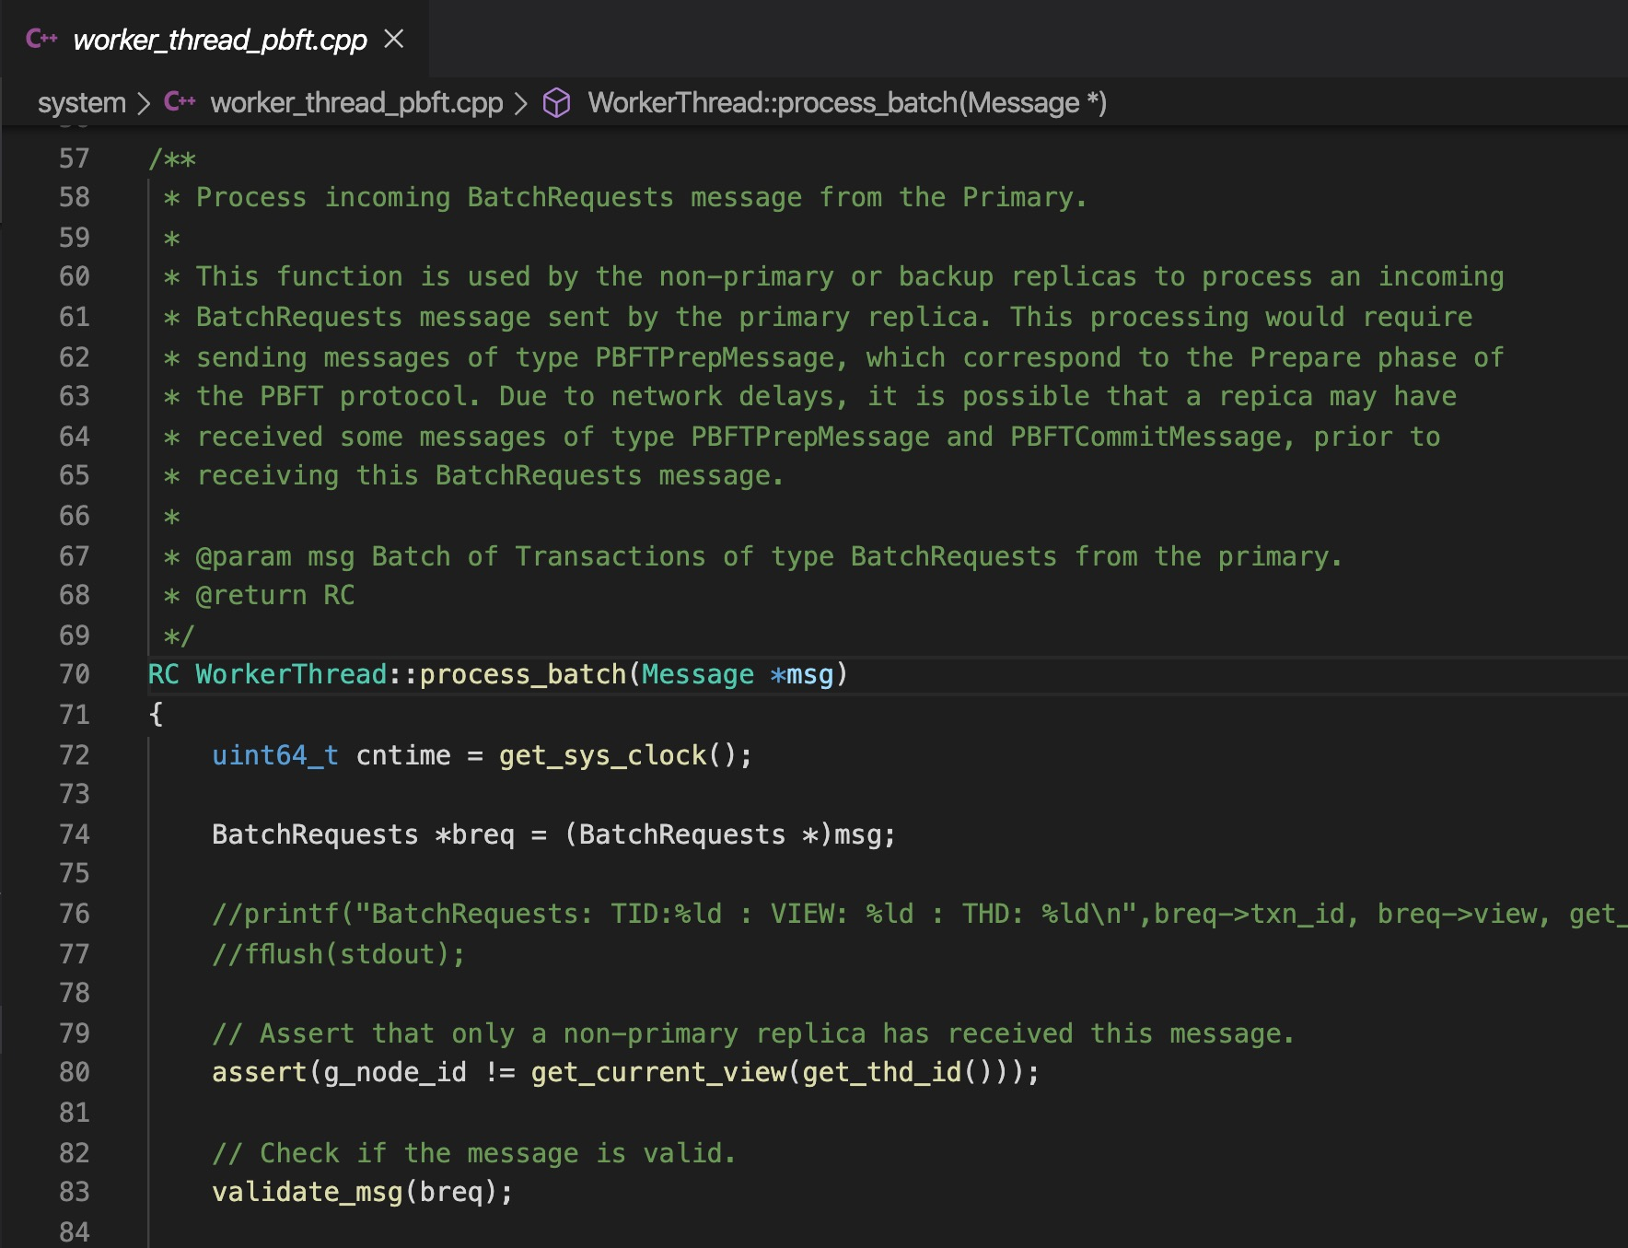
PBFT: Practical Byzantine Fault Tolerance
Process Batch Request (Prepare)
System/worker_thread_pbft.cpp
process_batch Function
Create and Send Prepare Message
Create Transactions
Save Digest
PBFTPrepare Class
Prepare Message

Slide 59
PBFT Failure-Free Flow
Client
T
Primary
Replica 1
Replica 2
Byzantine
Replica
Client
Request
Pre-Prepare
O(n)
Prepare
O(n²)
Commit
O(n²)
Reply

Slide 60
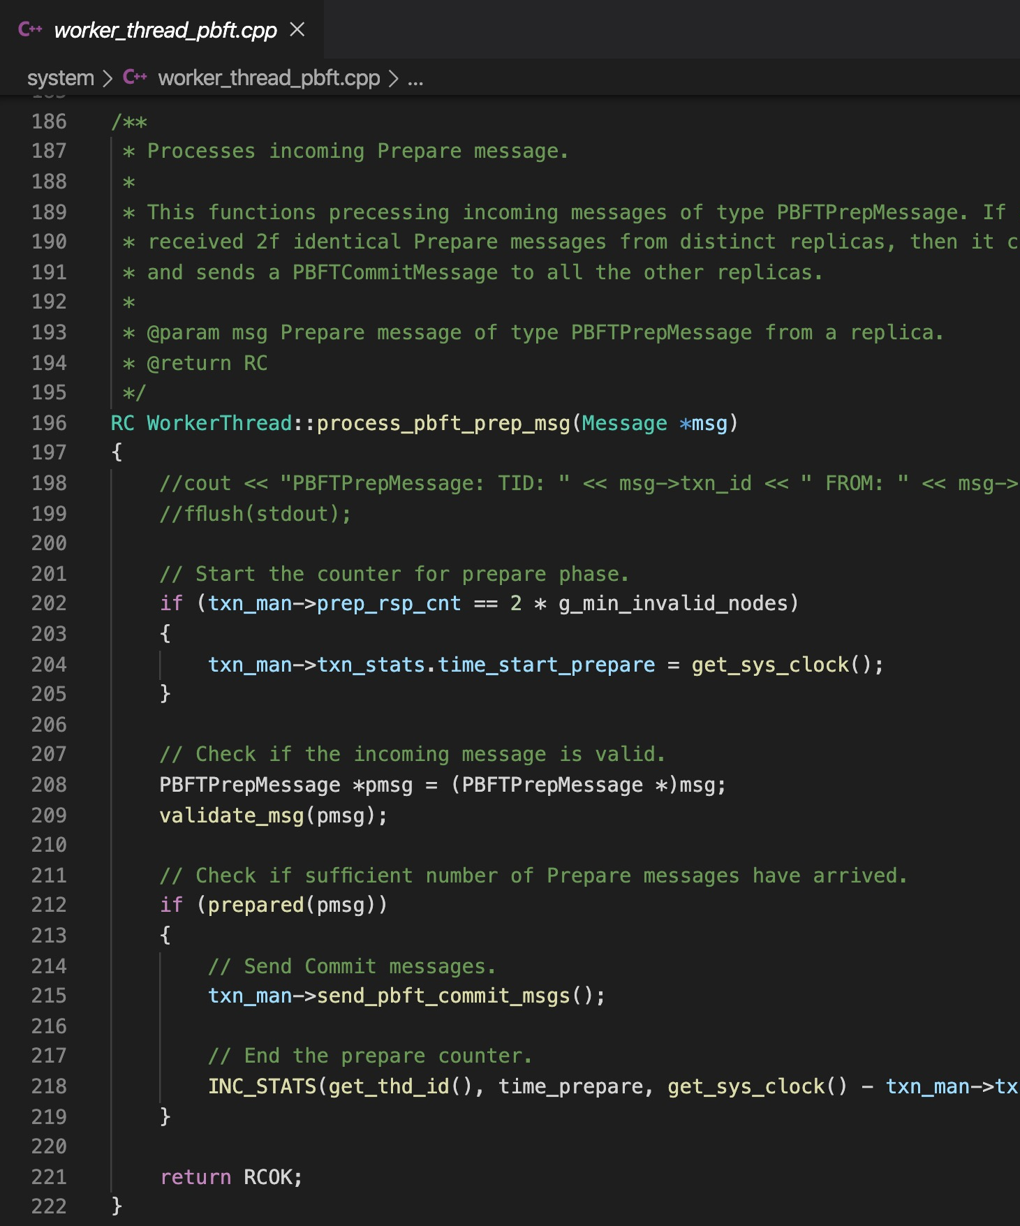
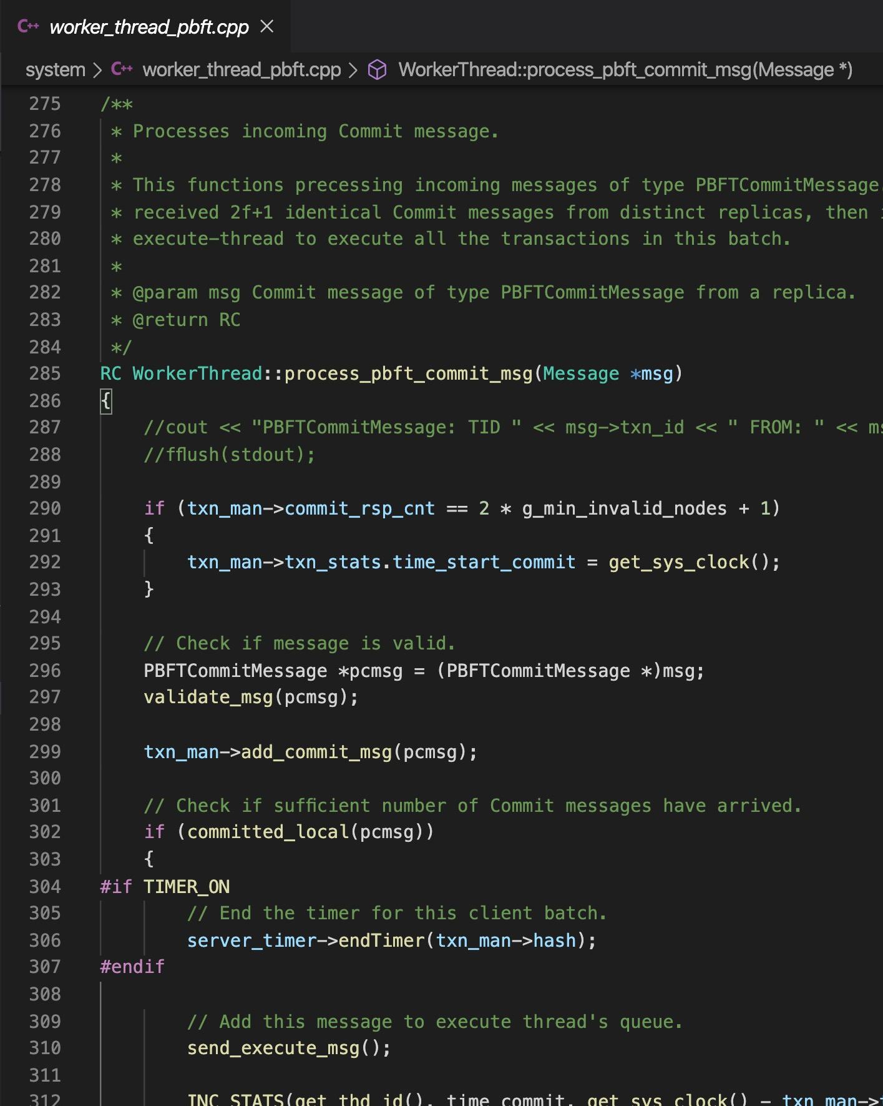
PBFT: Practical Byzantine Fault Tolerance
Process Prepare and Commit Messages(Prepare)
System/worker_thread_pbft.cpp
process_pbft_prepare Function
Count Prepare Messages
Create and Send commit Message
PBFTCommit Message
process_pbft_commit Function
Count commit messages
Create and Send execute Message
ExecuteMessage Class

Slide 61
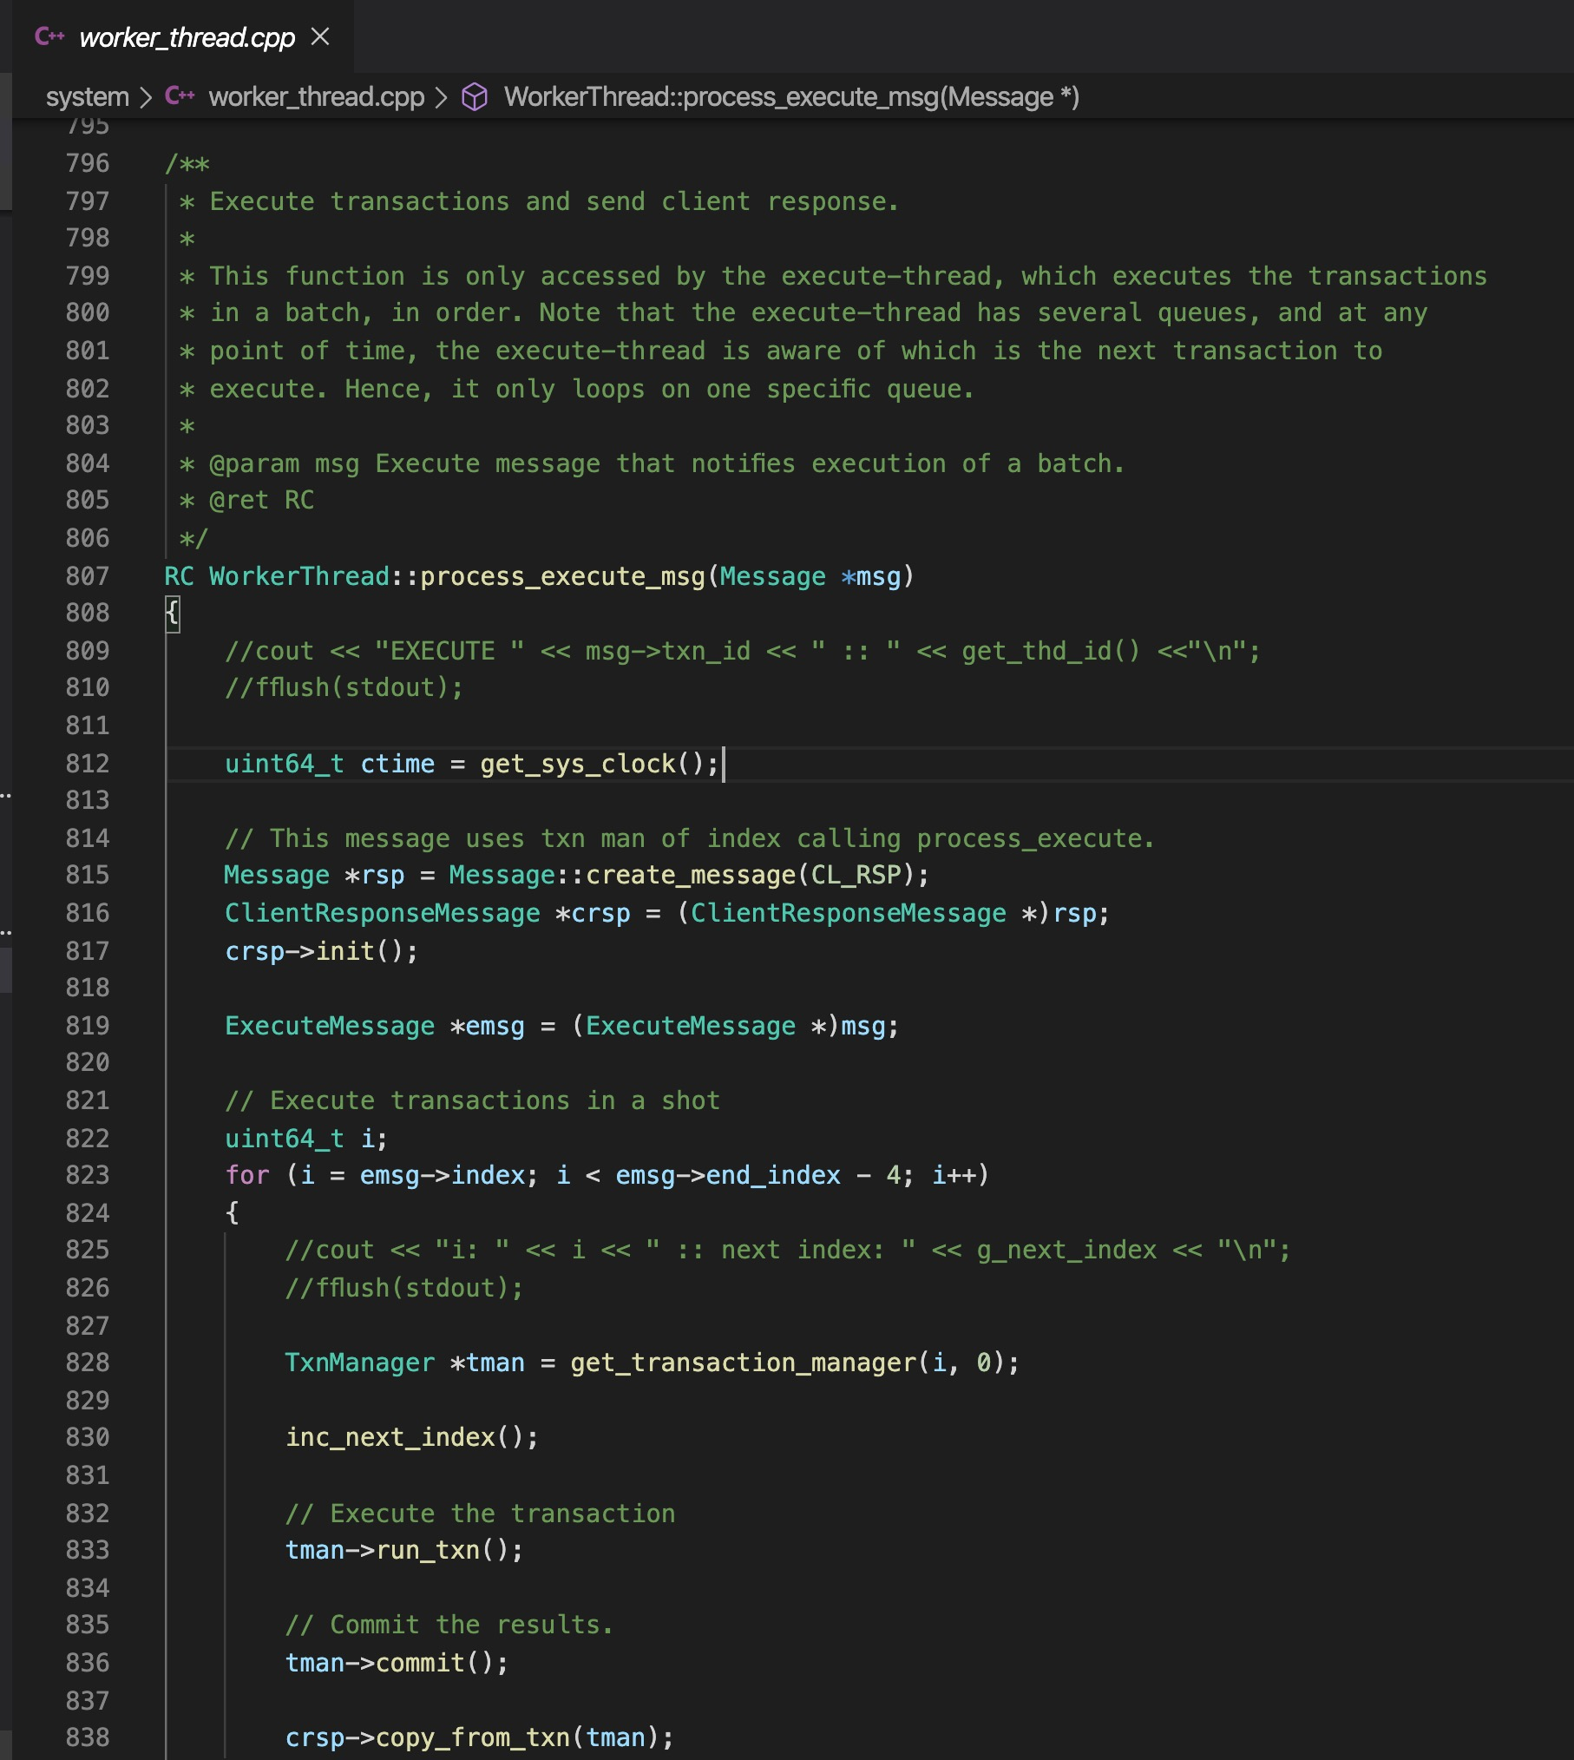
PBFT: Practical Byzantine Fault Tolerance
Process Execute Message
System/worker_thread.cpp
Internal Message
process_execute Function
Execute the Transactions in batch in order
Create and send Client Response
ClientResponse Class

Slide 62
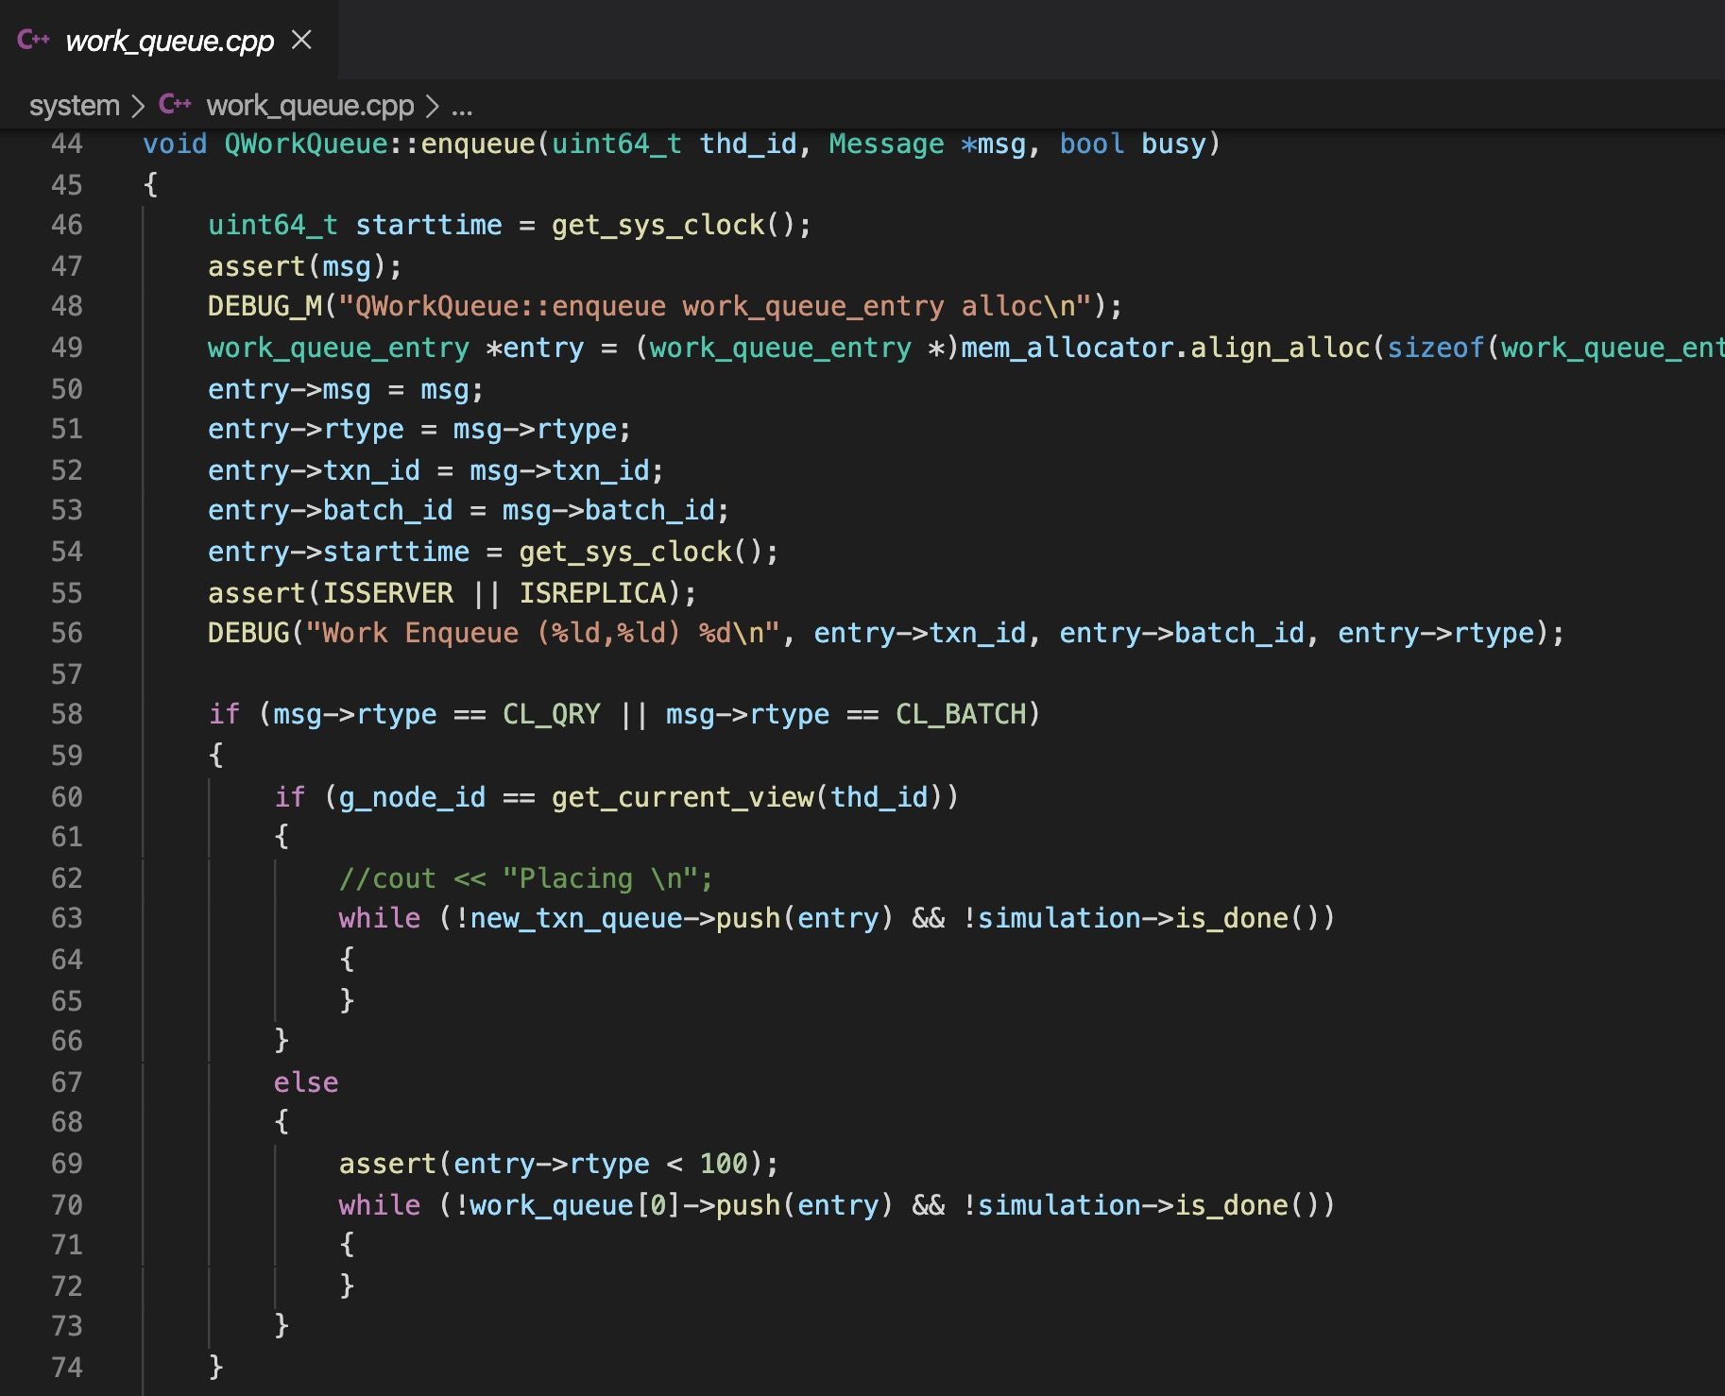
PBFT: Practical Byzantine Fault Tolerance
Work Queue
Lock Free queues
All the messages are being stored in these queues
System/work_queue.cpp
Multiple queues for different Threads
Dequeue and Enqueue Interfaces
Enqueue in IOThread
Dequeue in Worker Thread

Slide 63
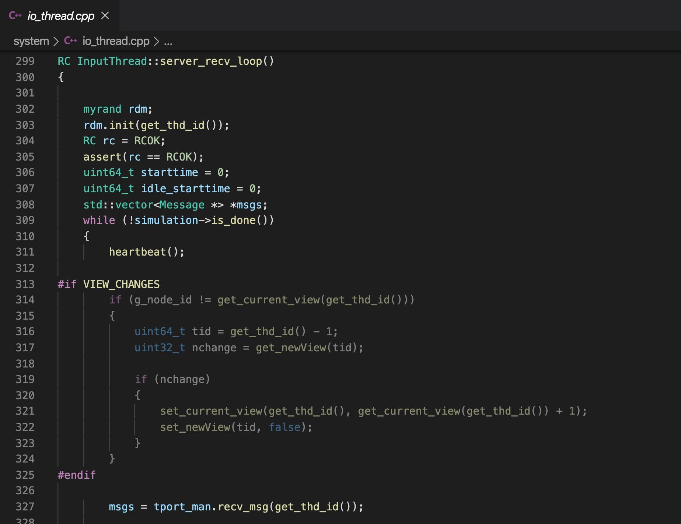
PBFT: Practical Byzantine Fault Tolerance
IO Thread and Transport Layer
Multiple Input Threads
Multiple Output Threads
System/io_thread.cpp
Transport Layer: TCP Sockets
Nano Message Library
Transport/transport.cpp

Slide 64
Thank You

